Slide 1


APPA Town Hall: Impact of COVID 19
Dedensifying Your Spaces

Slide 2
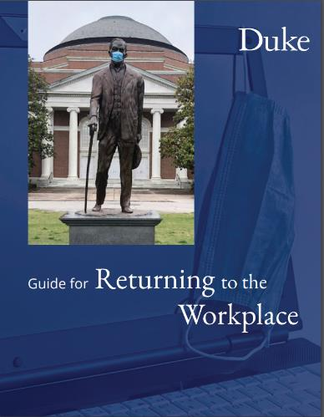
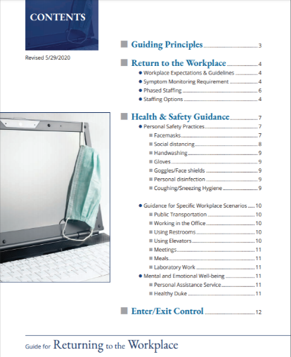
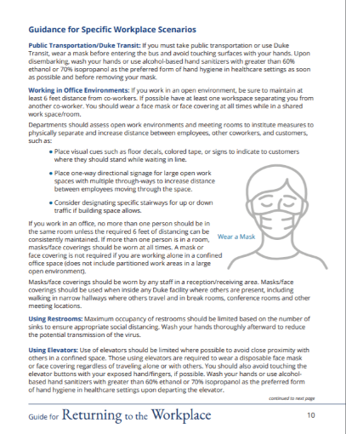
Guide for Returning to the Workplace

Slide 3
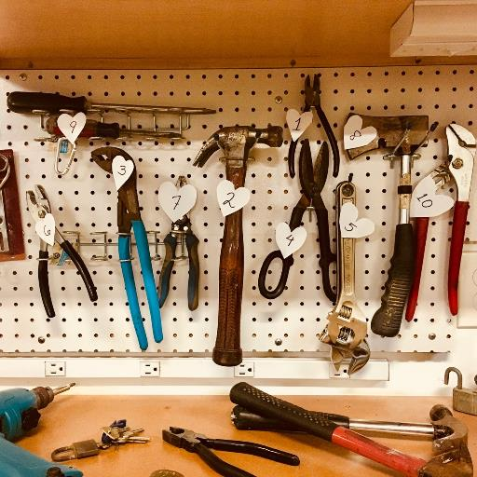
Building Re-Opening Toolkit

Slide 4
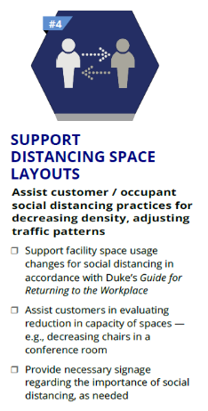
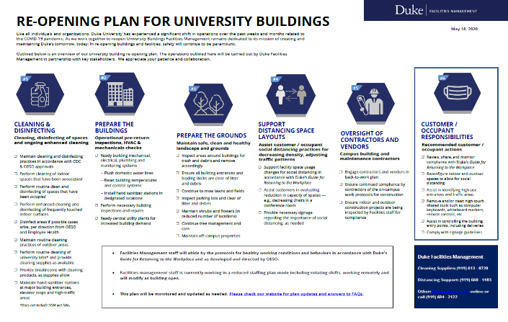

One Page Overview

Slide 5
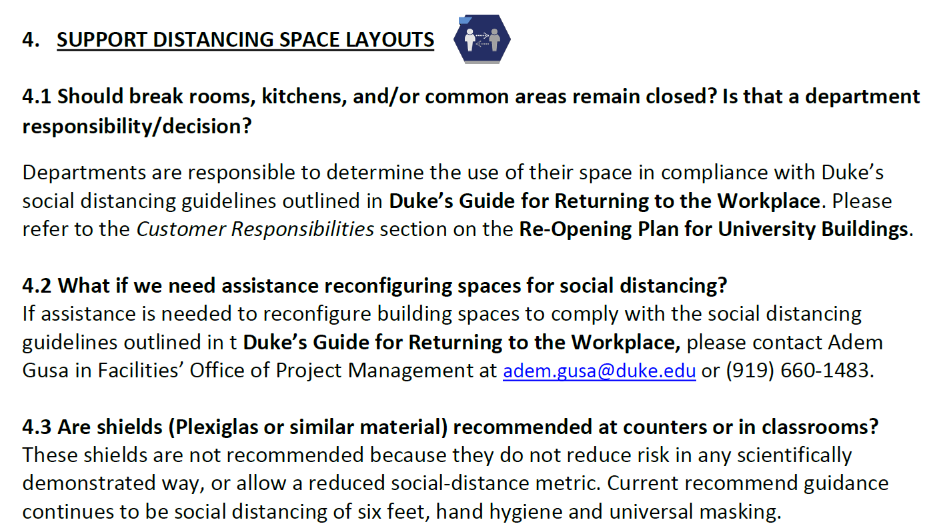
FAQs

Slide 6
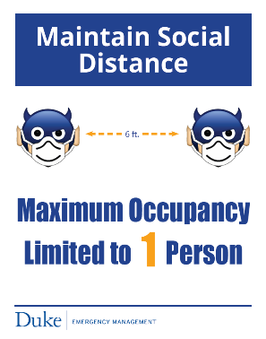
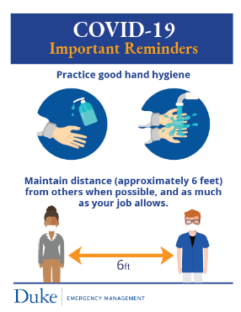
Fliers & Signs
FLOOR
SIGNS
FLIERS

Slide 7

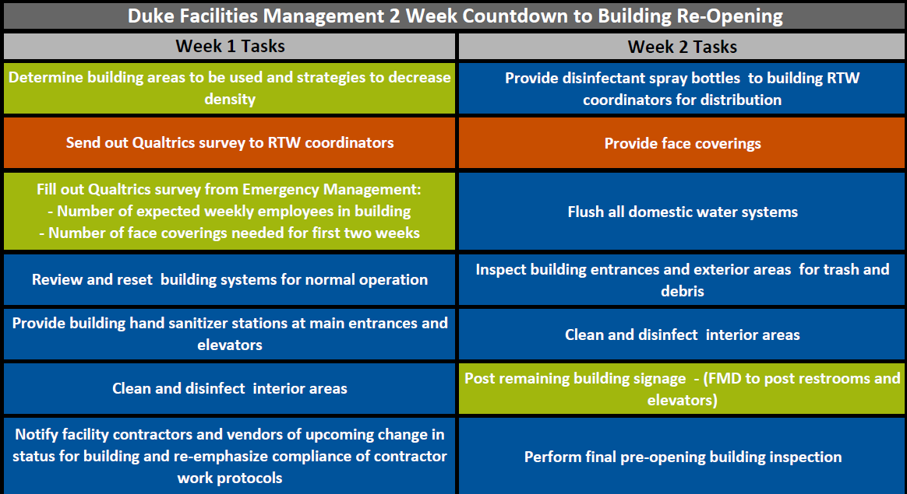

2-Week Facility Re-Open Task List

Slide 8
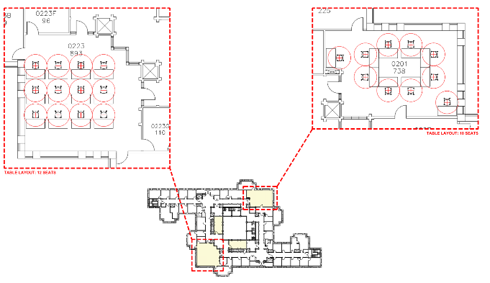
Dedensifying Campus
6’ social distancing in-place
Architectural test-fits have been underway to determine the impacts of social distancing for the following space types:
  Classrooms/Seminar Rooms/Auditoriums
  Class Labs
  Research Labs
  Dining
  Conference Rooms
  Break Rooms
  Lounges
  Open office environments
  P.E./Rec Rooms
Feedback will inform max capacities and numbers of sections needed for classes and class labs

Slide 9
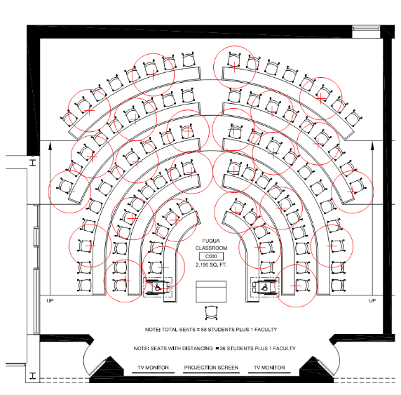
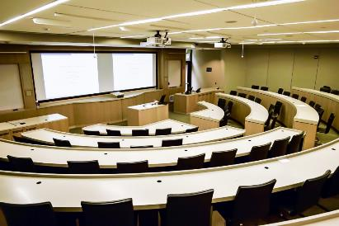
Dedensifying Campus - Classrooms
Tiered Lecture Style fixed seats
Current Seat Count: 88 (25 SF/STA)
6’ Distancing Count: 26 (84 SF/STA)

Slide 10
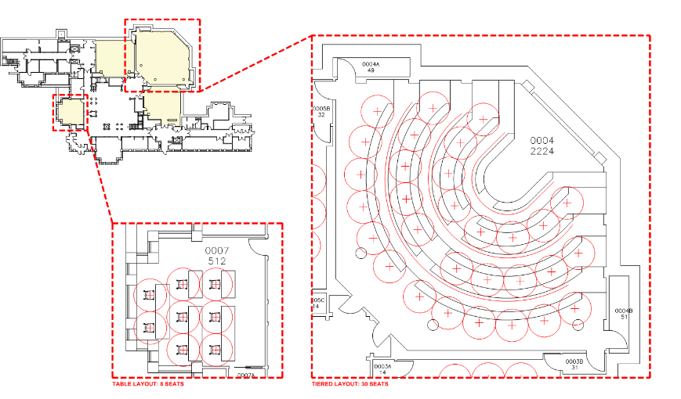
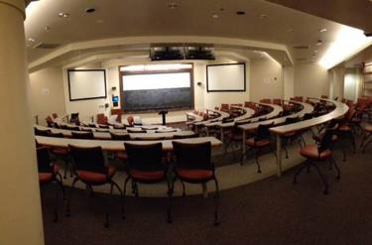
Dedensifying Campus - Classrooms
Tiered Lecture Style flex seats
Current Seat Count: 111 (20 SF/STA)
6’ Distancing Count: 30 (74 SF/STA)

Slide 11
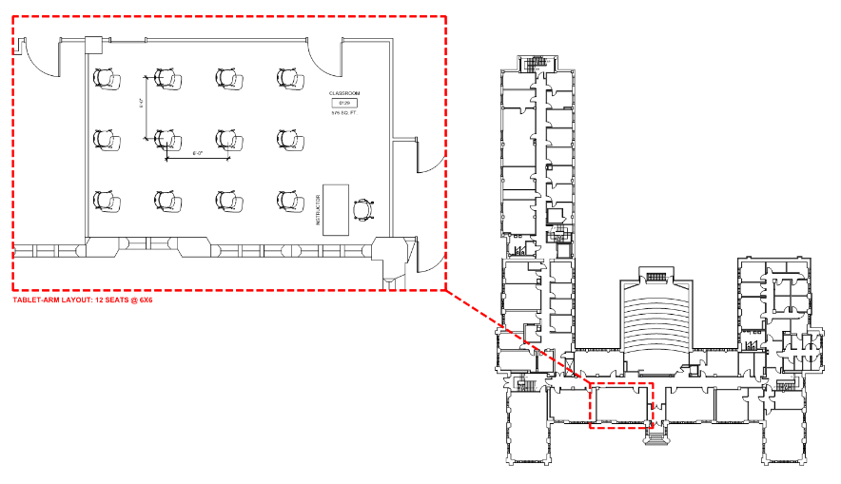
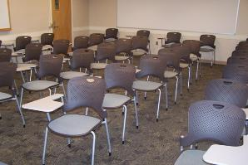
Dedensifying Campus - Classrooms
Tablet Arm vs. Tables
Current Seat Count: 28 (20 SF/STA)
Tablet Arm @ 6’ Distancing: 12 Seats (48 SF/STA)

Slide 12
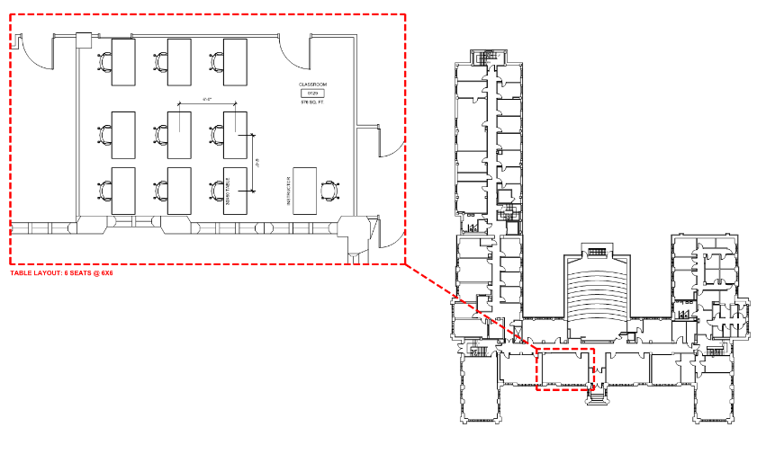
Dedensifying Campus - Classrooms
Tablet Arm vs. Tables
Current Seat Count: 28 (20 SF/STA)
Flex Tables @ 6’ Distancing: 9 Seats (63 SF/STA)

Slide 13
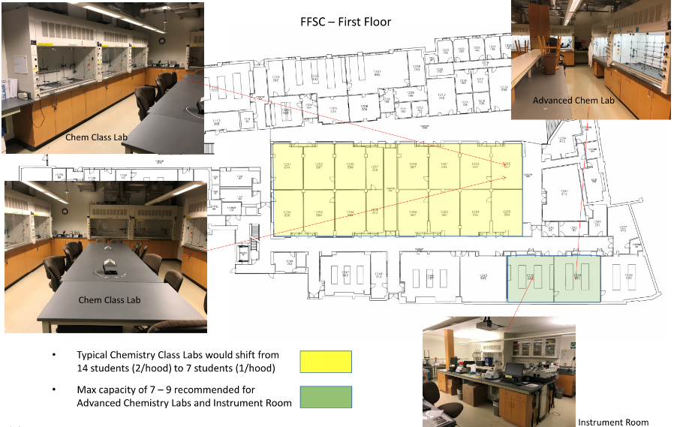
Dedensifying Campus – Class Labs

Slide 14
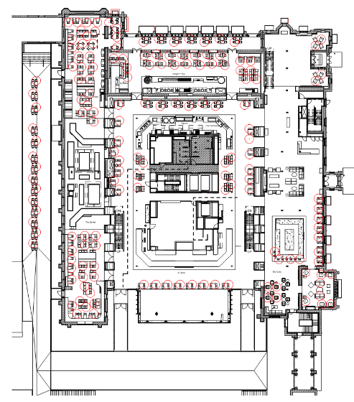
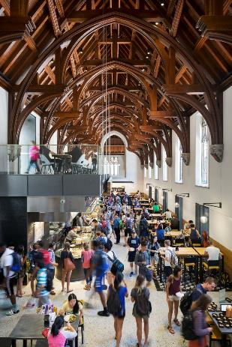
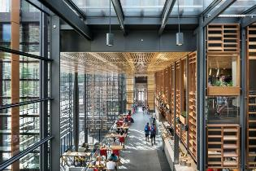
Dedensifying Campus - Dining
Main Student Union – Plaza Level
Current Seat Count: 438
6’ Distancing Count: 121
27% of Seats Accomodated

Slide 15
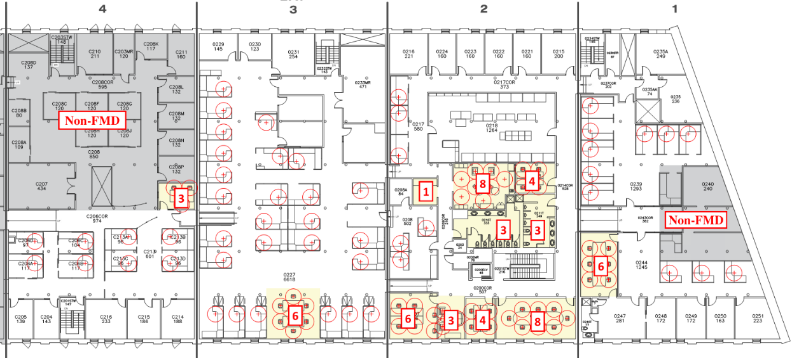

Dedensifying Campus – Conference Rooms, RRs, Break Rooms & Work Stations

Slide 16
Dedensifying Campus – Lessons Learned
Test-fits are critical to determine actual impacts vs. hypothetical calculated impacts
The numbers of sections needed to teach the same number of students sometimes doubles
For class labs, the equipment can be a limiting factor more than seating (e.g. fume hoods, microscopes, etc.)
For the most part, open workstations are not impacted by 6’ distancing
Dining impacts are significant and may result in ‘grab & go’ becoming the norm
Dorm rooms going from doubles to singles has ripple-effects on student life and on-campus capacity
Early communication with Provost’s Office, Sr. Admin and Registrar’s Office is key.

