Slide 1
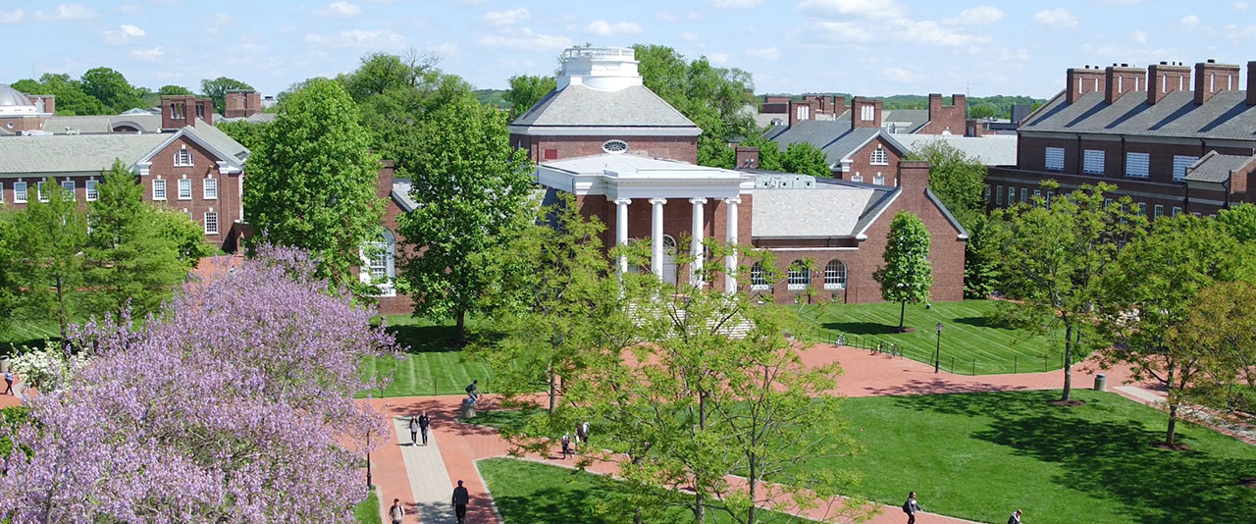
Trees in the Campus Landscape
Tom Flood, MBA, CEFP, ASLA
AVP for Facilities Operations
University of Delaware

Slide 2
Trees in the Campus Landscape
Agenda
Design & Selection
Purchasing & Planting
Tree Protection
Tree Management
Plans, Programs & Inventories

Slide 3
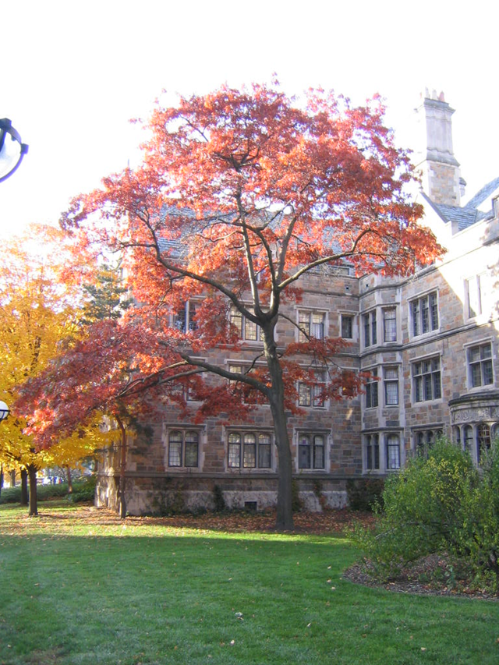
Campus Trees
WHY TREES?
Create habitat
Protect & improve soils
Reduce erosion &
storm water run off
Reduces heat
Improves air quality

Slide 4
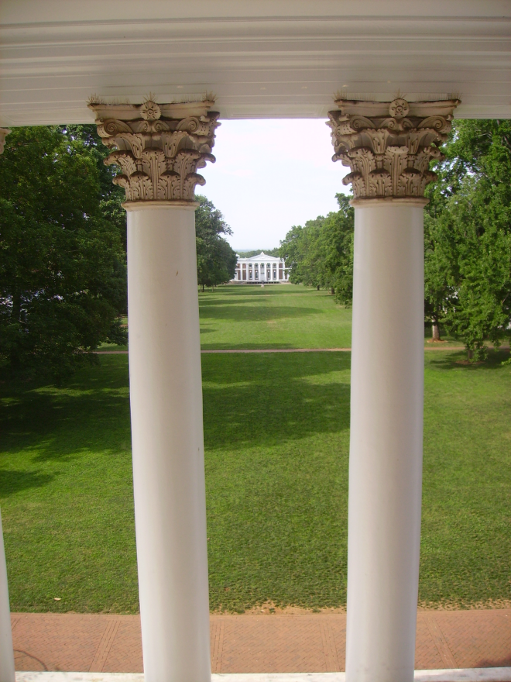
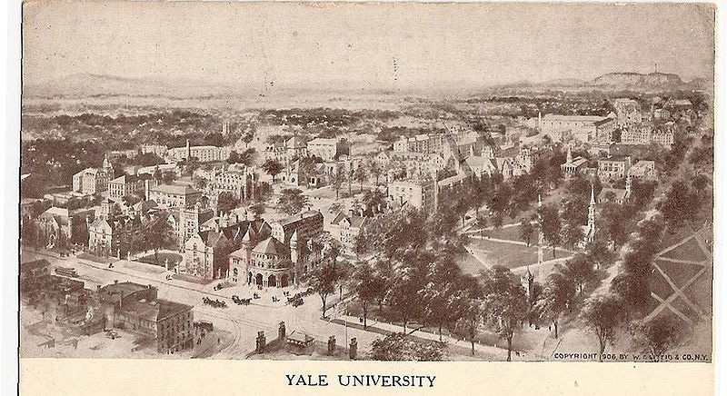
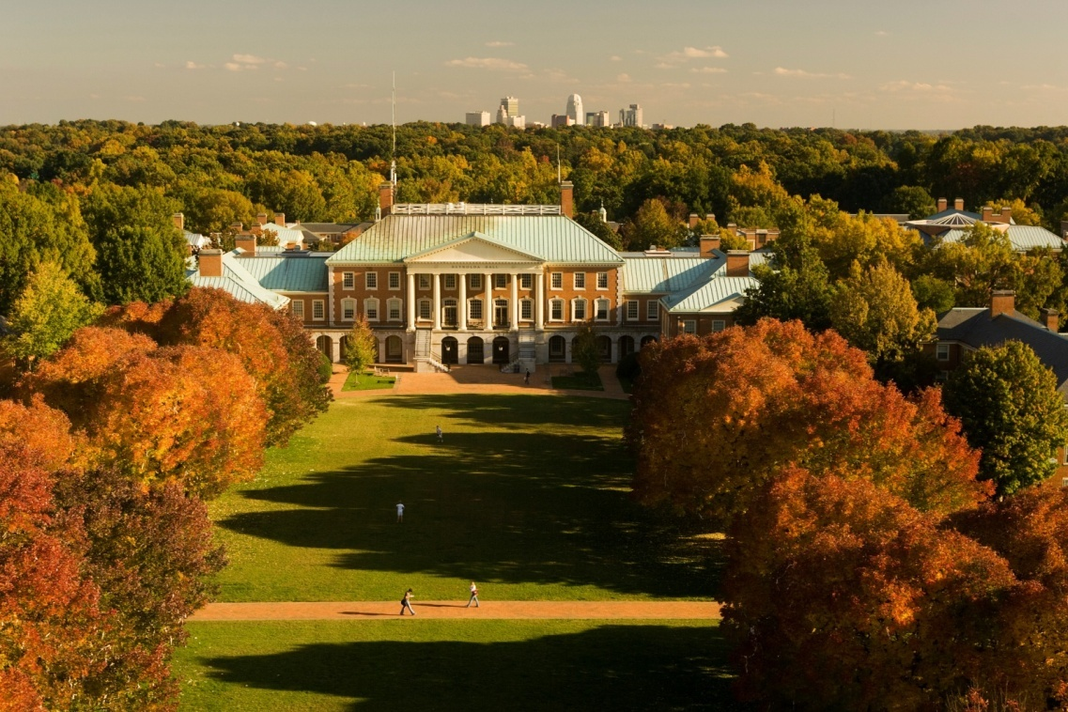
Campus Trees
Create a sense of place
Livable campus

Slide 5
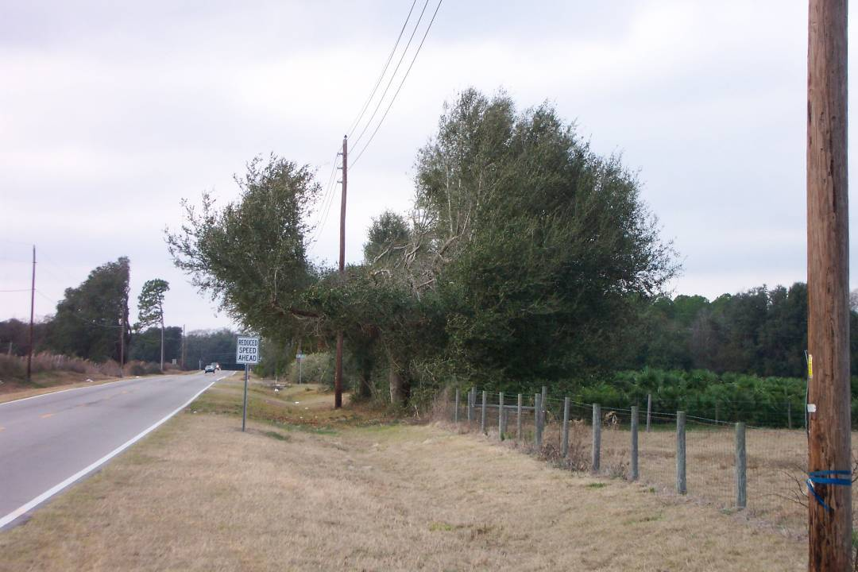
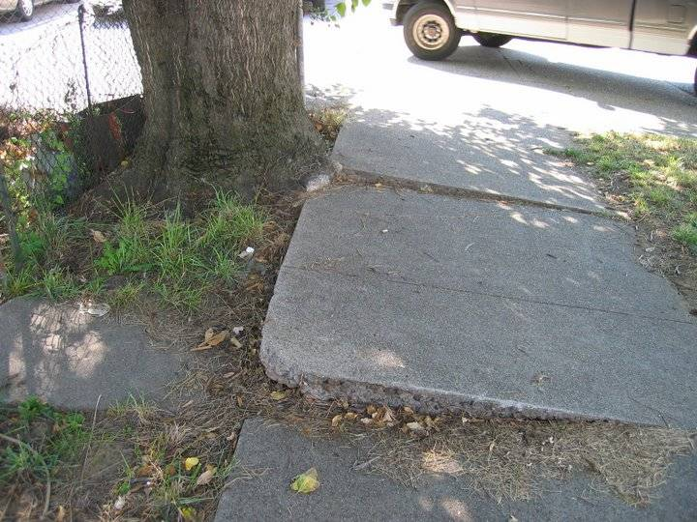
Design & Selection
Right plant, Right place

Slide 6
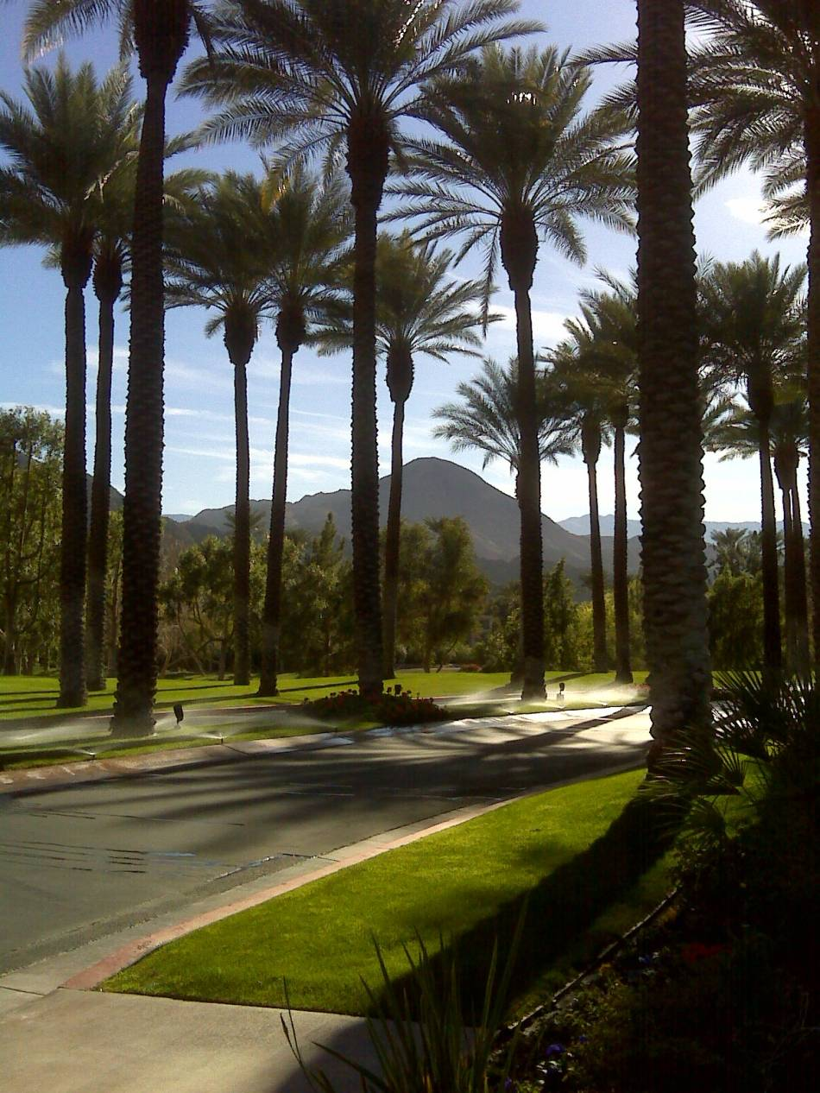
Design & Selection
Site evaluation
Soil type
Soil moisture
Sun exposure
Available space
Maintenance practices

Slide 7
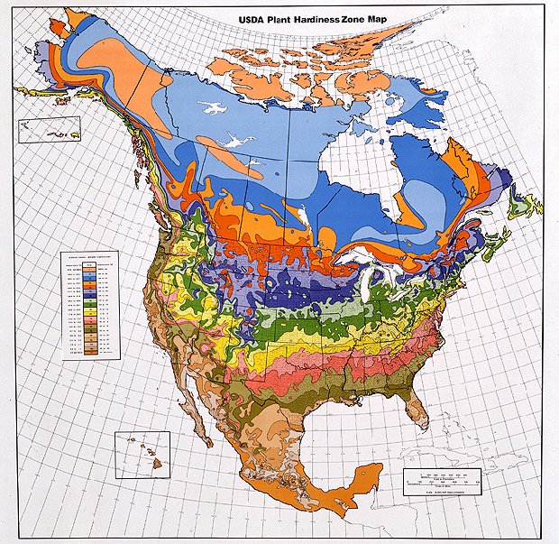
Design & Selection
Tree attributes
Hardiness zone
Heat zone

Slide 8
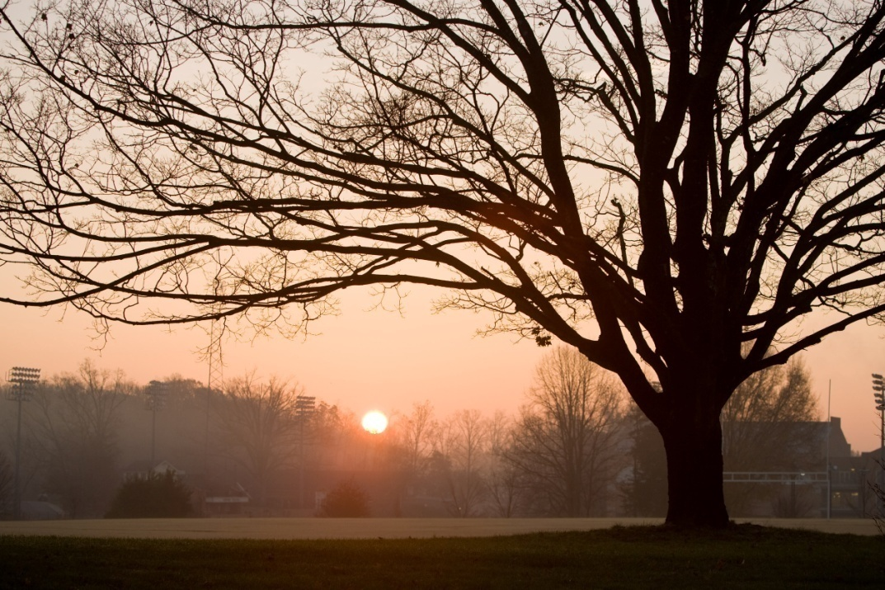
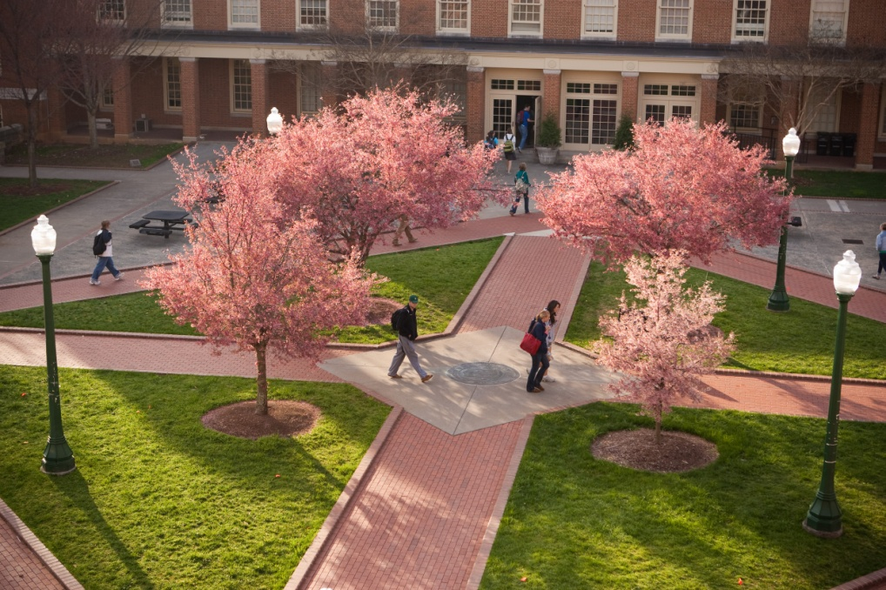
Design & Selection
Tree attributes
Mature size
Cultural requirements
(moisture, light, soil)

Slide 9
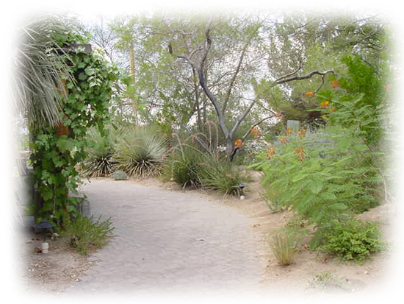
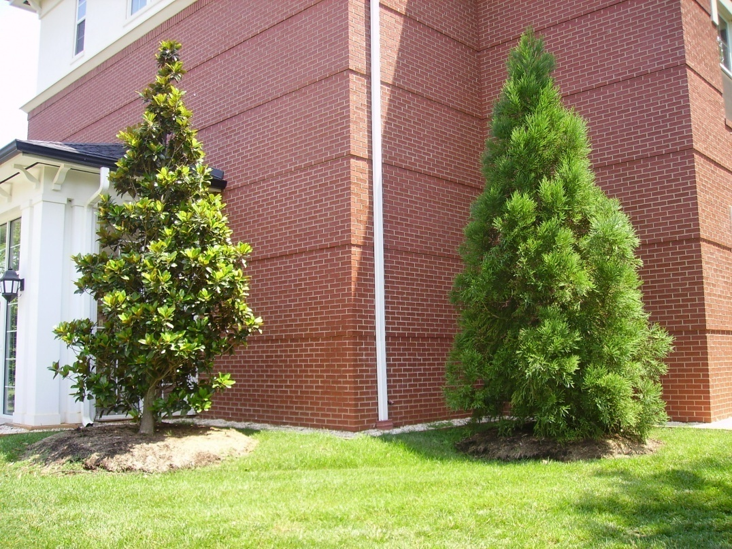
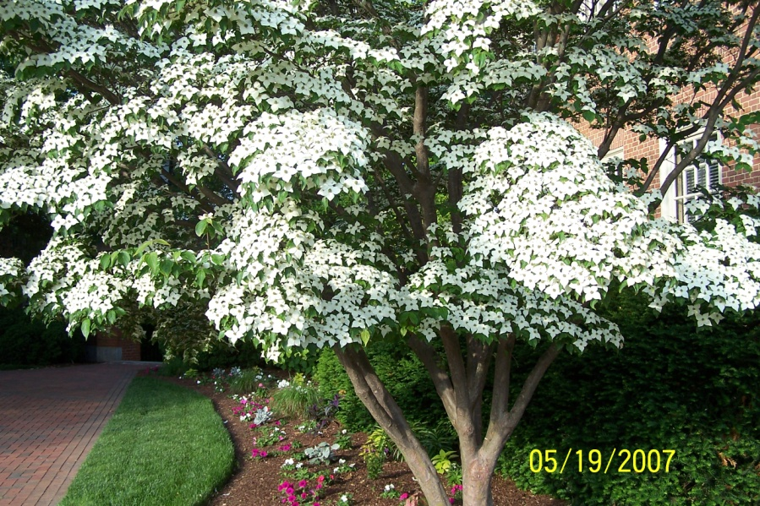
Design & Selection
Tree attributes
Maintenance requirements
Ornamental qualities

Slide 10
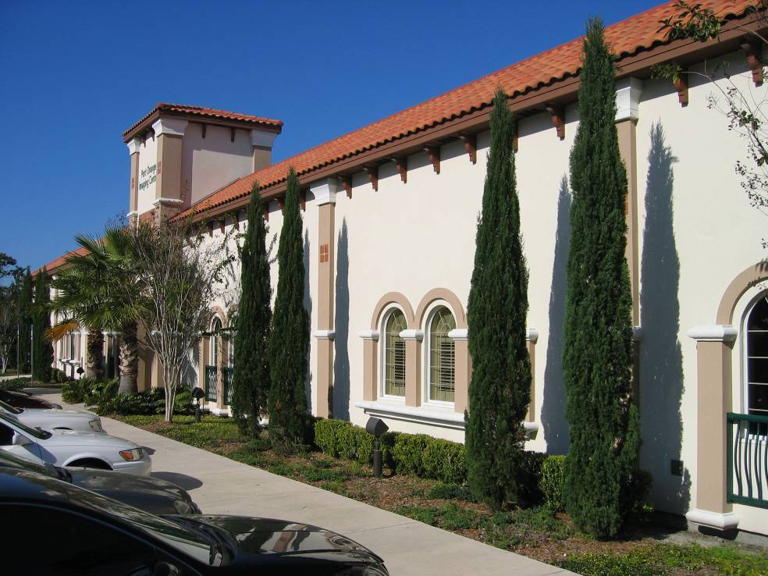
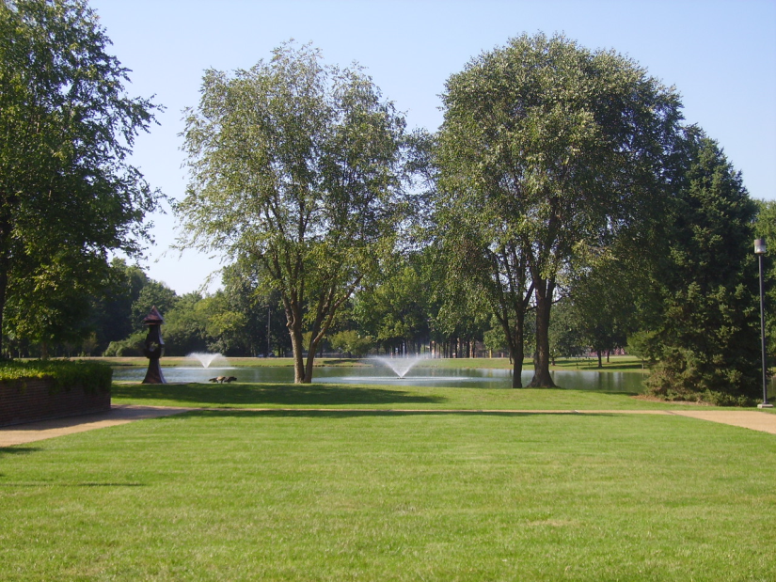
Design & Selection
Design Requirements
Type
Form & Texture
Size & Scale
Ornamental
Qualities
Site Aesthetics
views
architecture, etc

Slide 11
Design & Selection Native vs, Non-Native
Eliminate the use of invasive plants.
An invasive species is defined as “an alien species whose introduction does or is likely to cause economic or environmental harm or harm to human health.”
This is not the same as non-native!

Slide 12
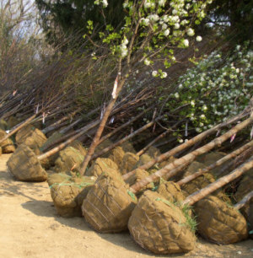
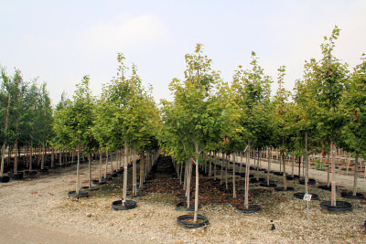
Purchasing & Planting
ANLA – Standard for Nursery Stock
Condition – container, B&B or bare root?

Slide 13
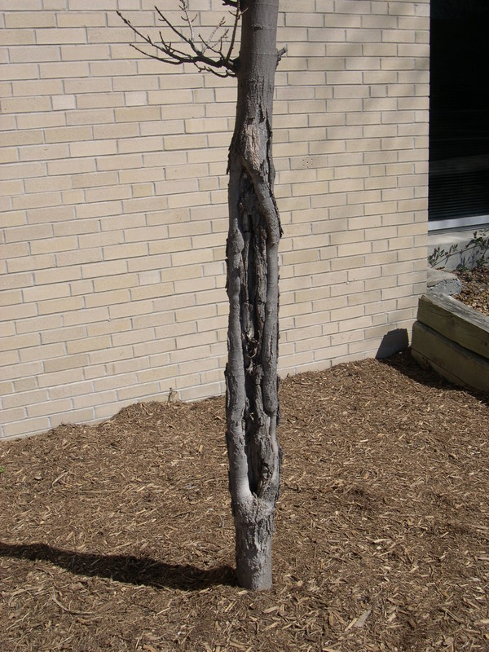
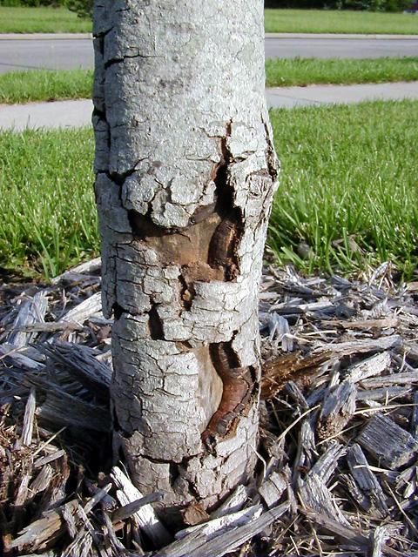
Purchasing & Planting
Field Tag Trees
Look for:
Branch structure
Trunk damage

Slide 14
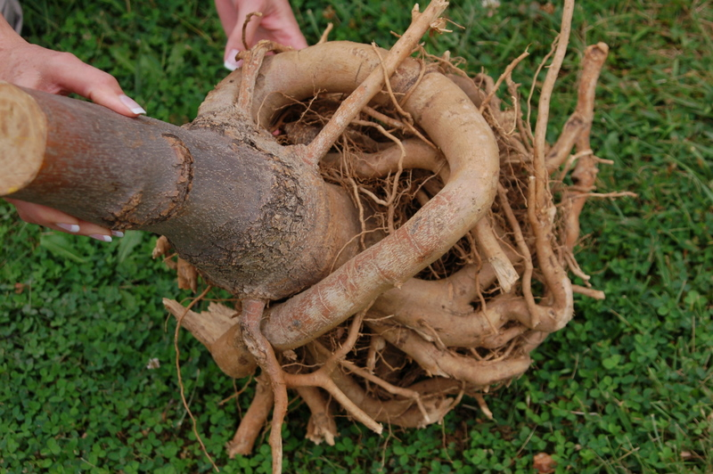
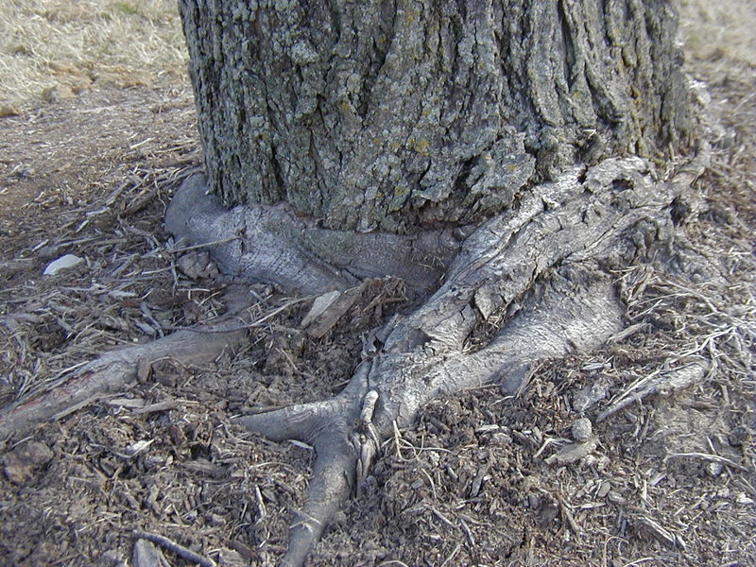
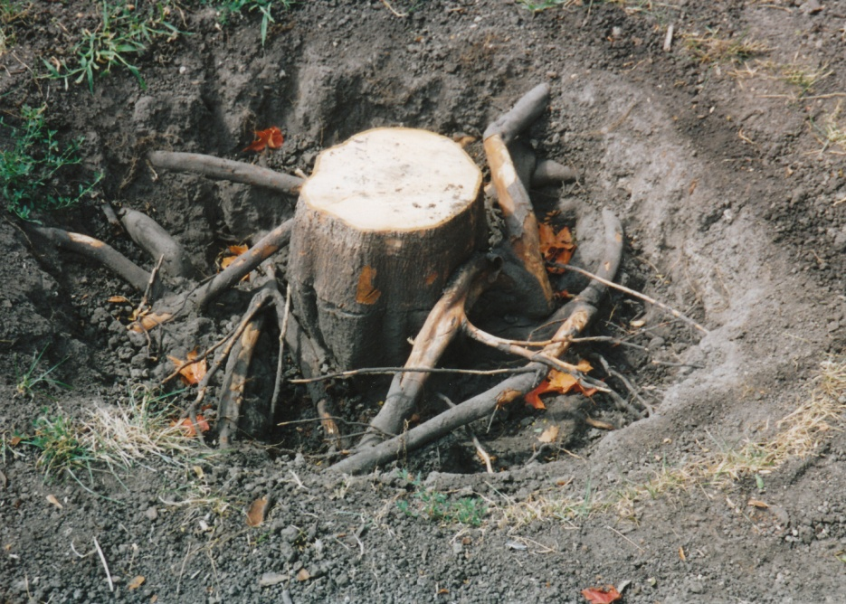
Purchasing & Planting
Field Tag Trees
Look for:
Proper rooting

Slide 15
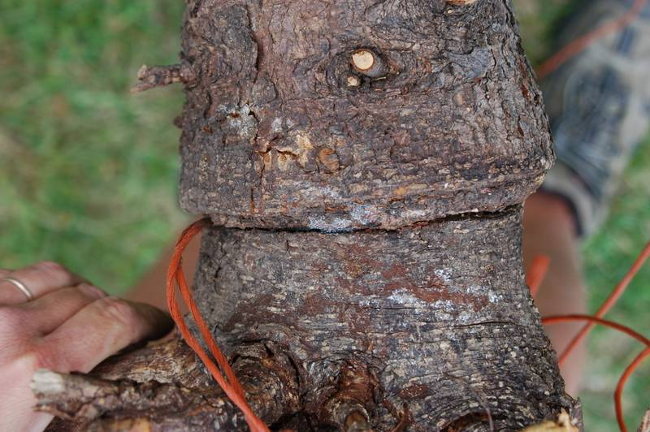
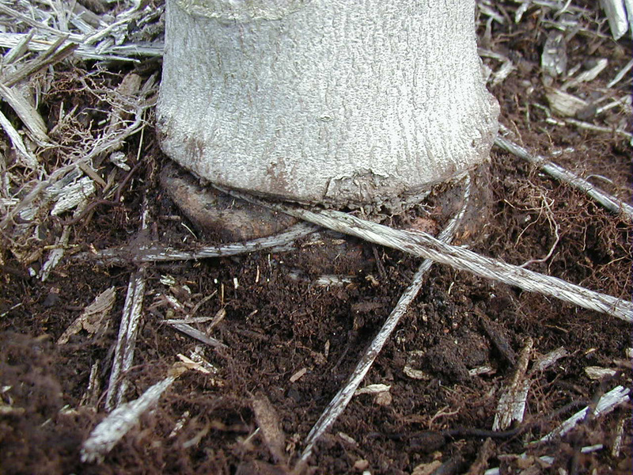
Purchasing & Planting
Field Tag Trees
Look for:
Holding & transport
Nursery management quality

Slide 16
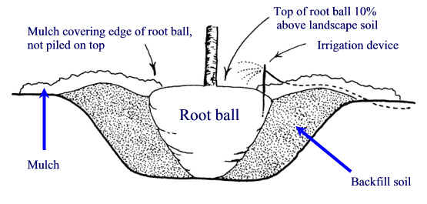
Purchasing & Planting
Site Prep – Deep Rip
Planting Hole
$10 hole for a $5 tree

Slide 17
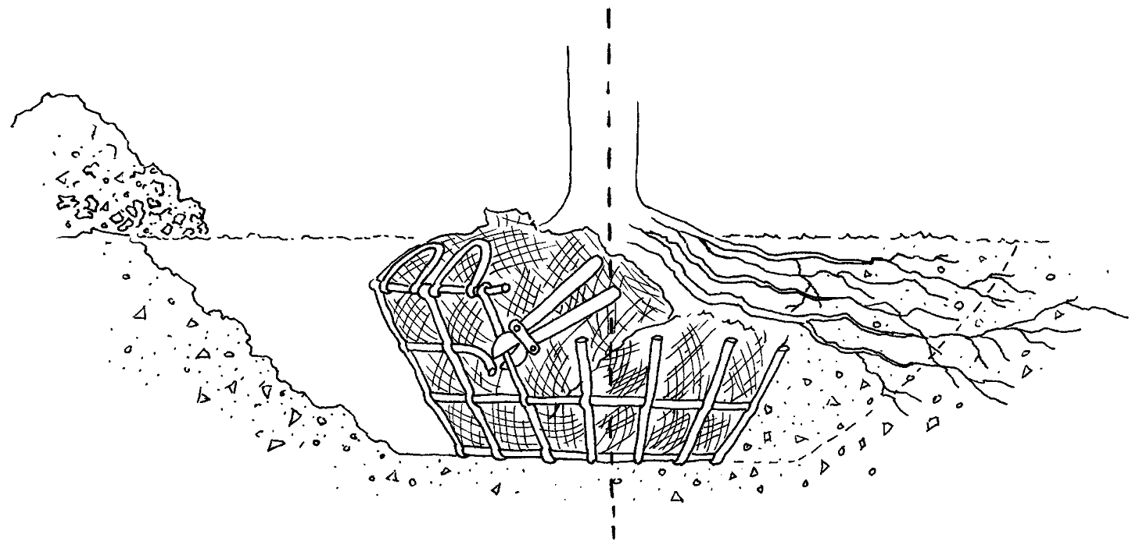
Purchasing & Planting
Planting depth

Slide 18
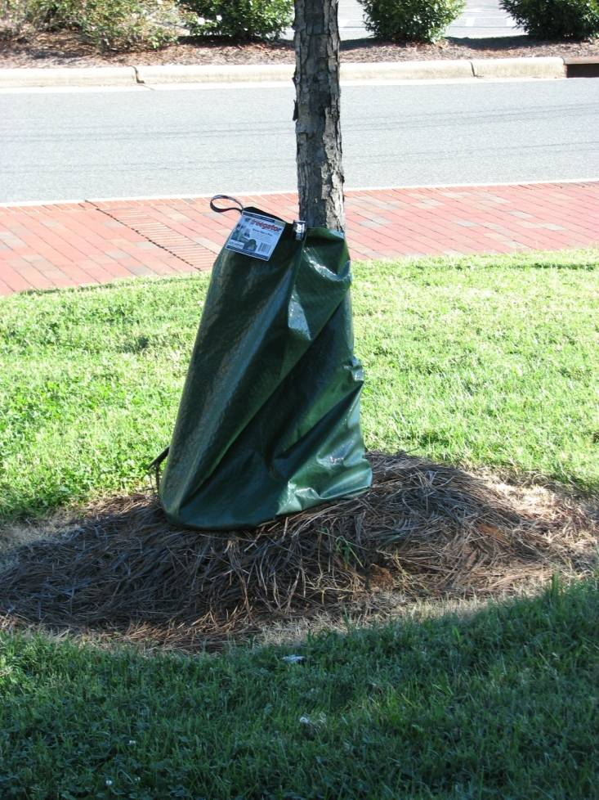
Purchasing & Planting
Establishment period
Staking
Pruning
Watering

Slide 19
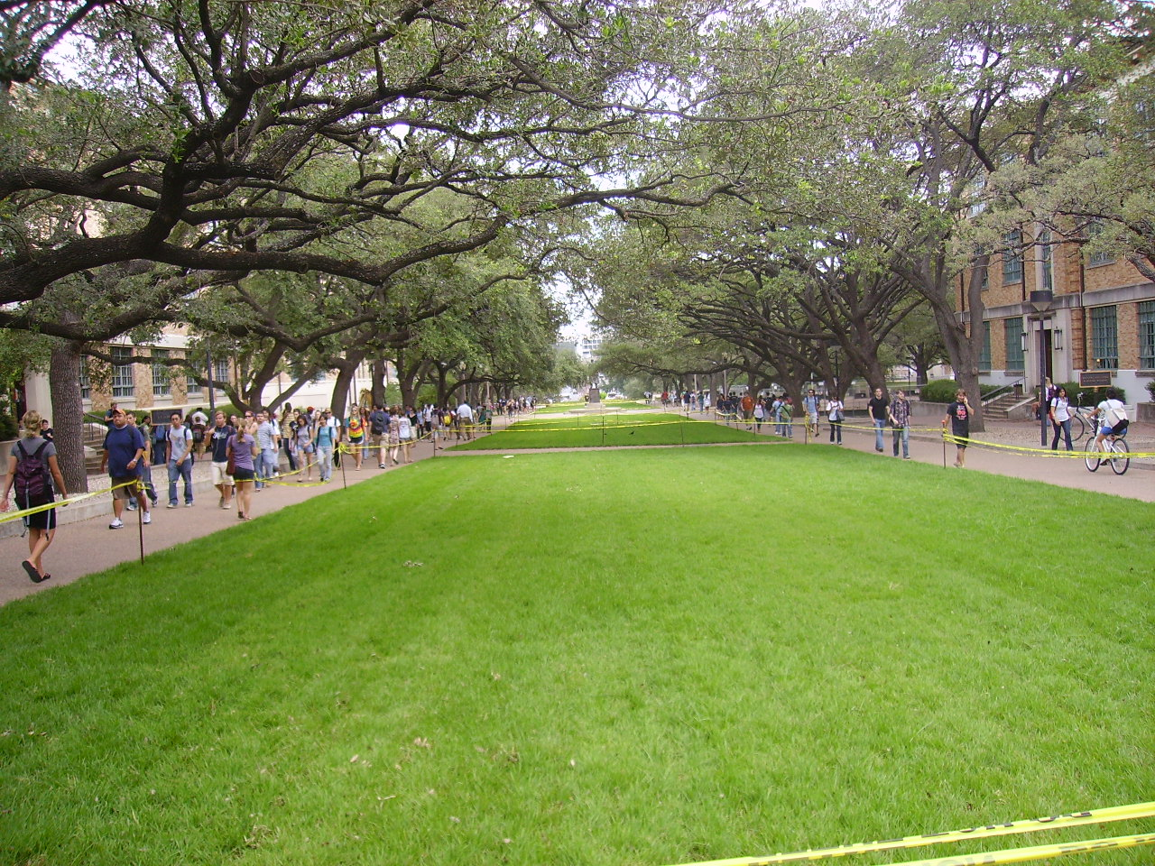
Tree Protection
Grass in weeks
Shrubs in years
Trees in a lifetime

Slide 20
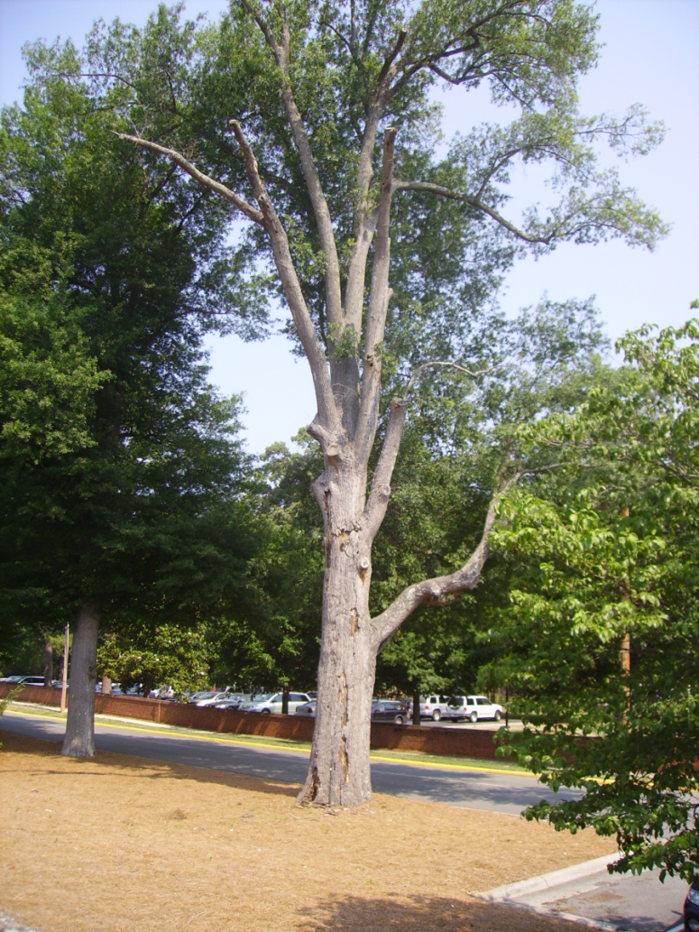
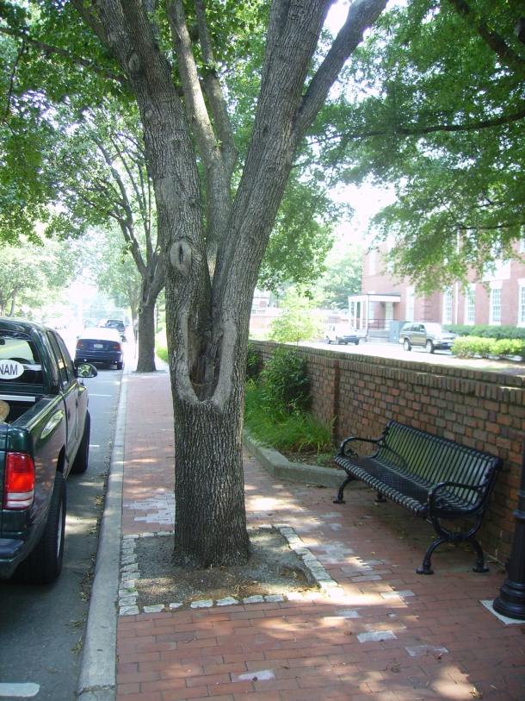
Tree Protection
Starts at preliminary design
Include protection and damages in general conditions
Show locations on plans
Be realistic about what
should be saved

Slide 21
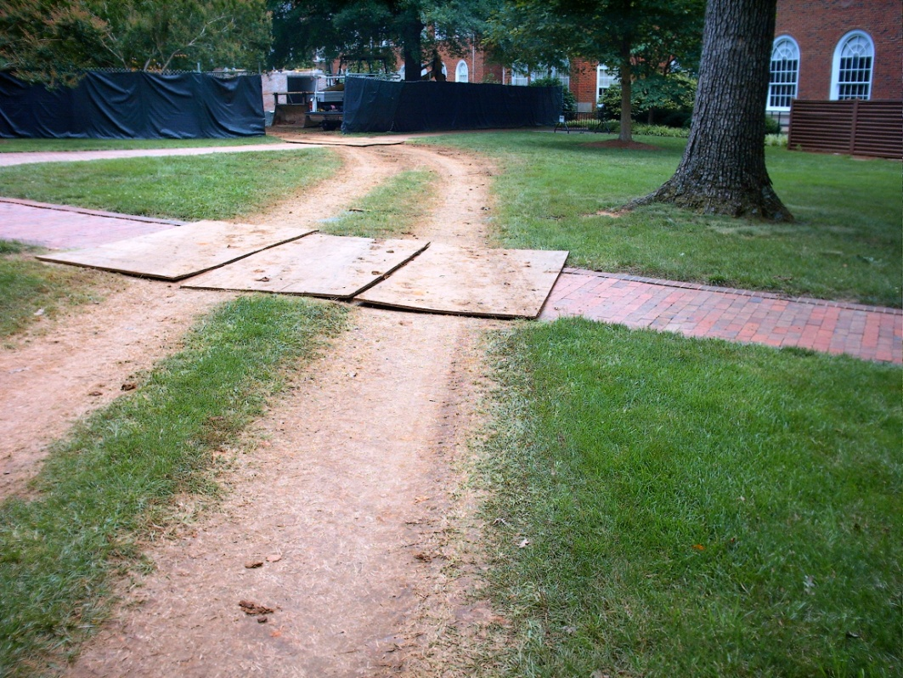
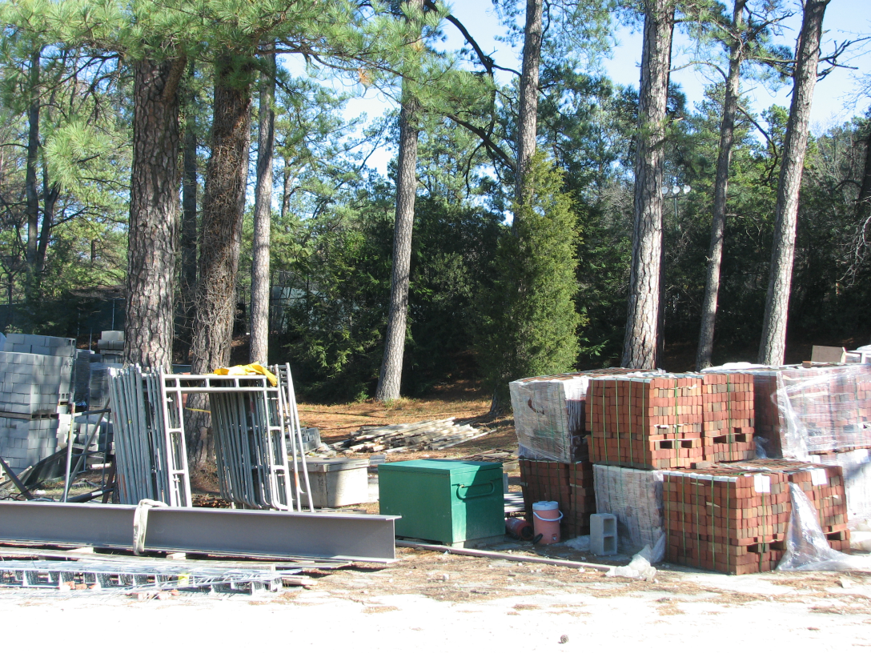
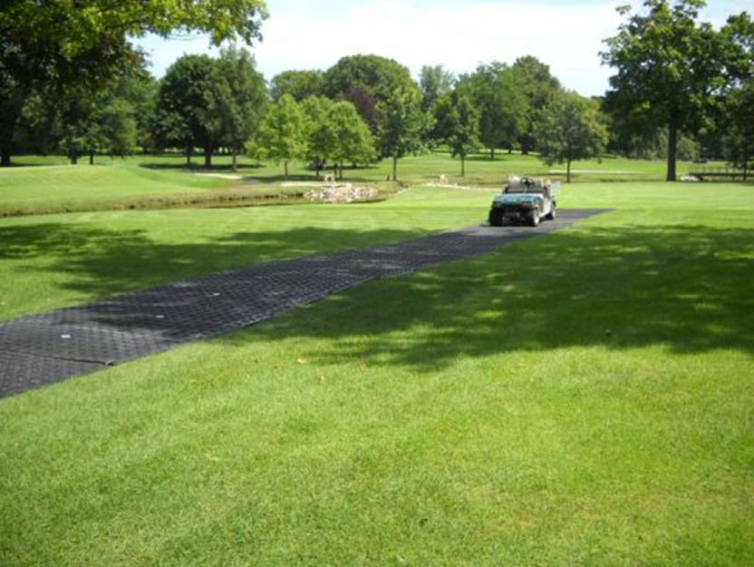
Tree Protection
Compaction reduces spaces for oxygen and water in the soil, reduces root growth and access to water and nutrients.

Slide 22
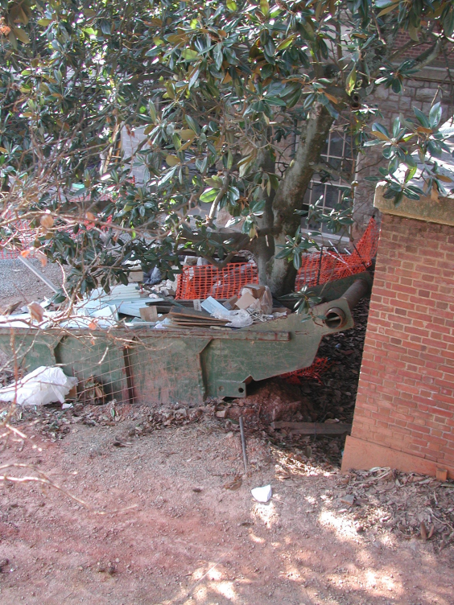
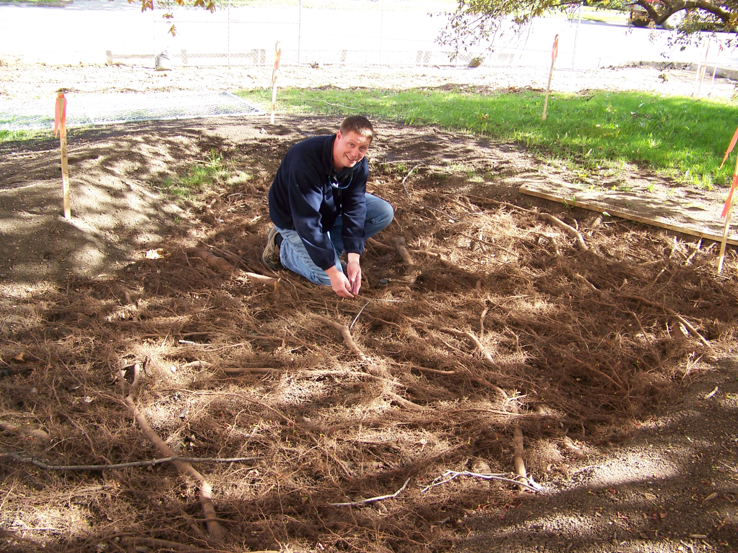
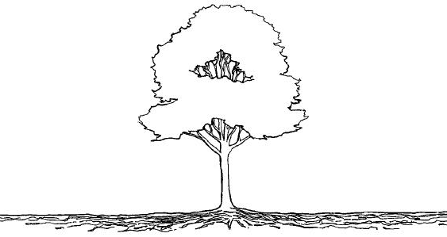
Tree Protection
Fencing
Minimum location
At drip line
1.5 x drip line
1 foot radius / 1inch diameter

Slide 23
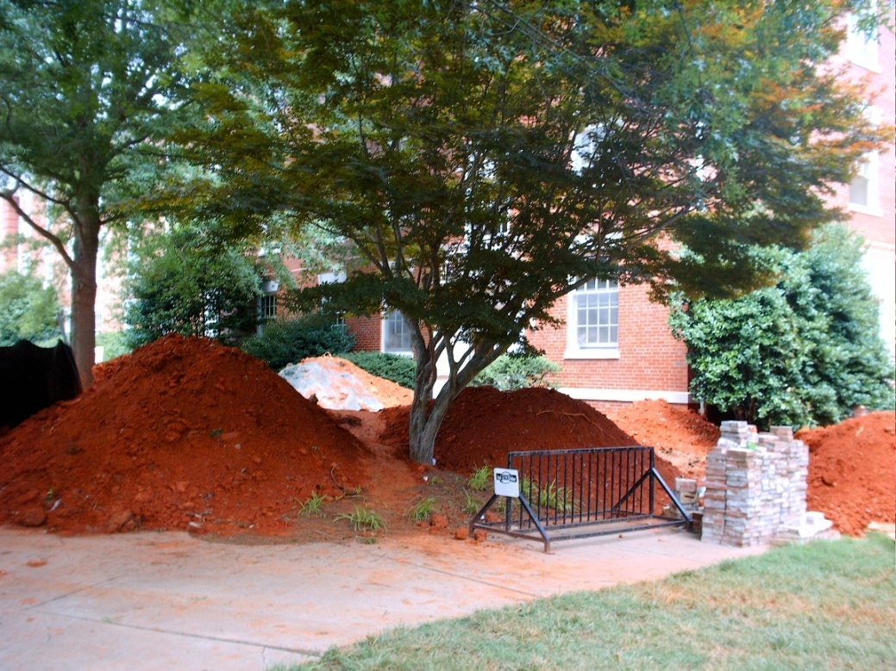
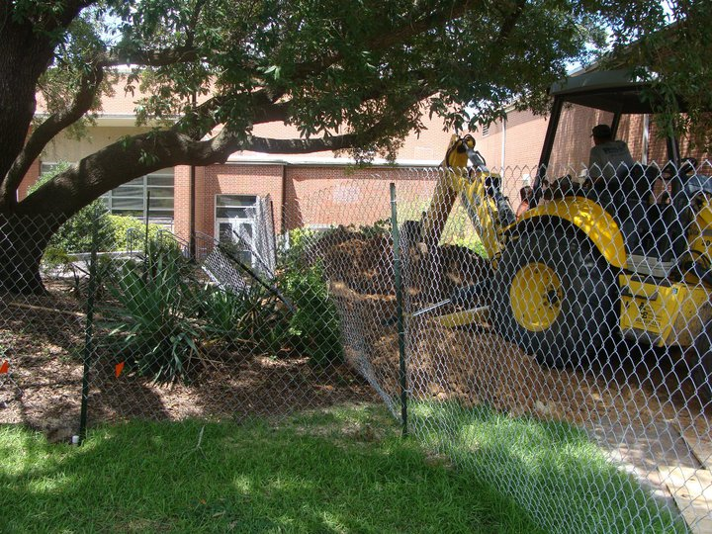
Tree Protection
Fencing
Installation & maintenance by ____?

Slide 24
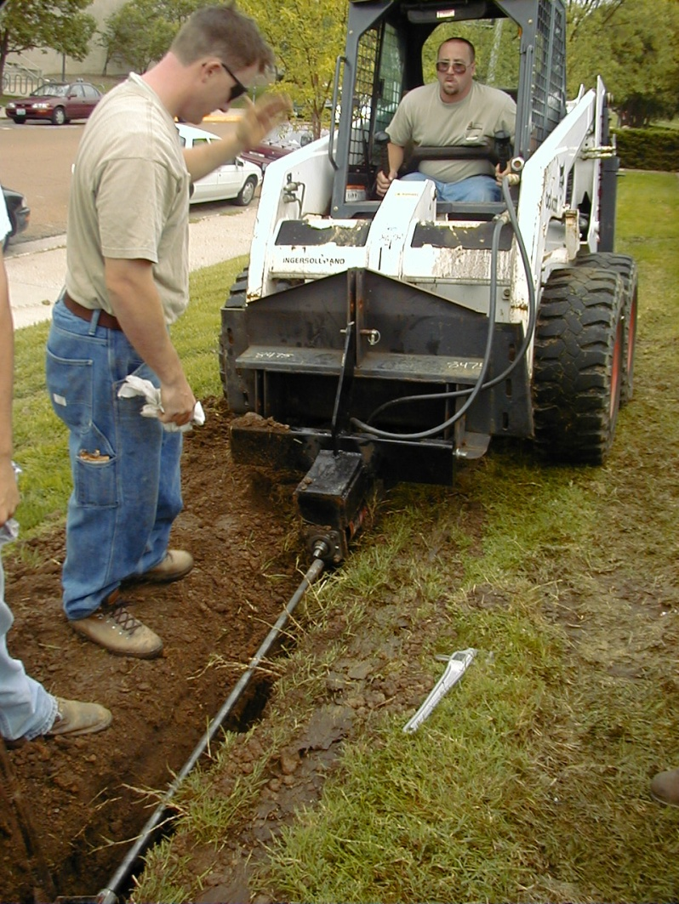
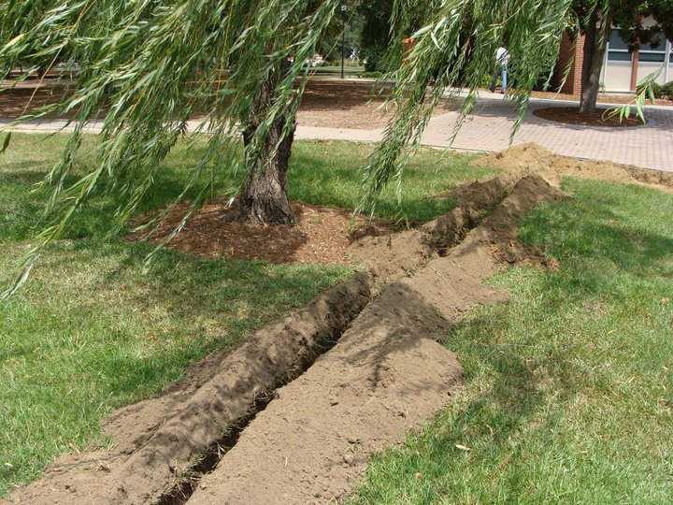
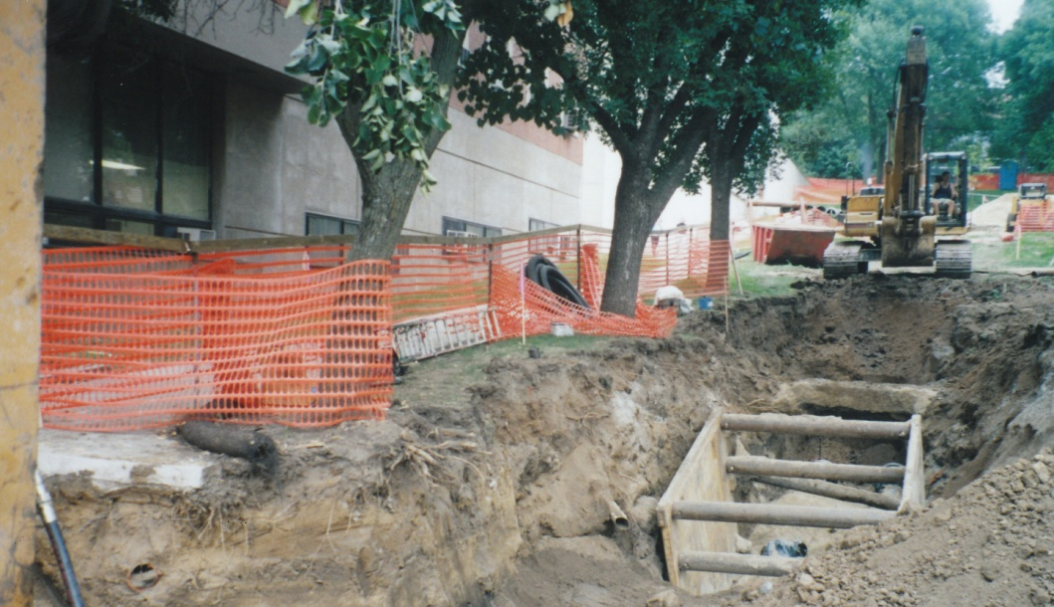
Tree Protection
Root protection
Trenching vs. boring

Slide 25
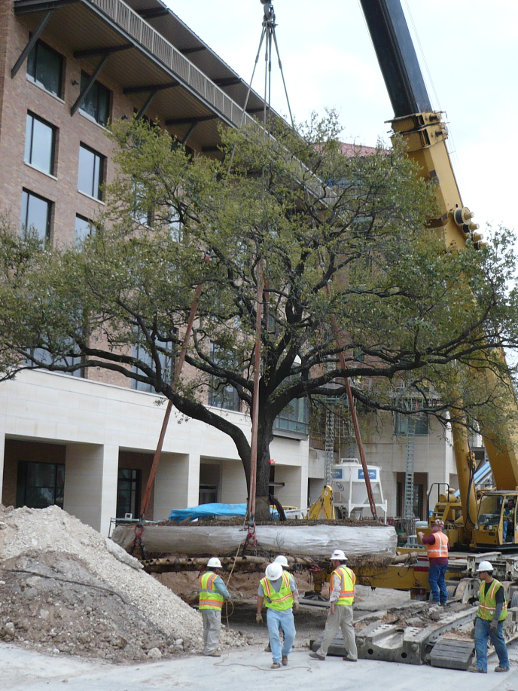
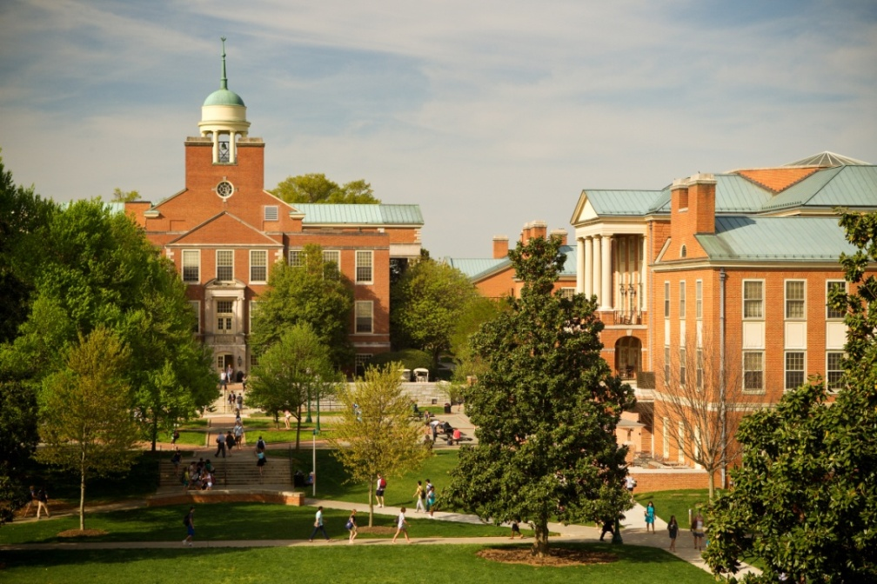
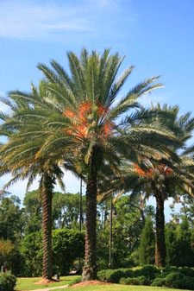
Tree Protection
Relocations – to move or not to move
Species
Size 4”-6”
Schedule
Cost

Slide 26
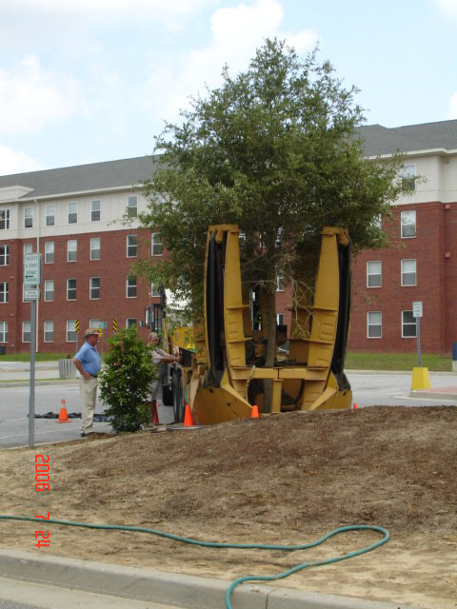
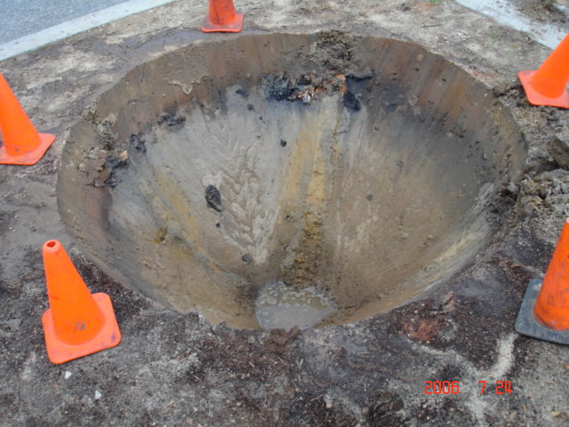
Tree Protection
Relocations
Tree spade

Slide 27
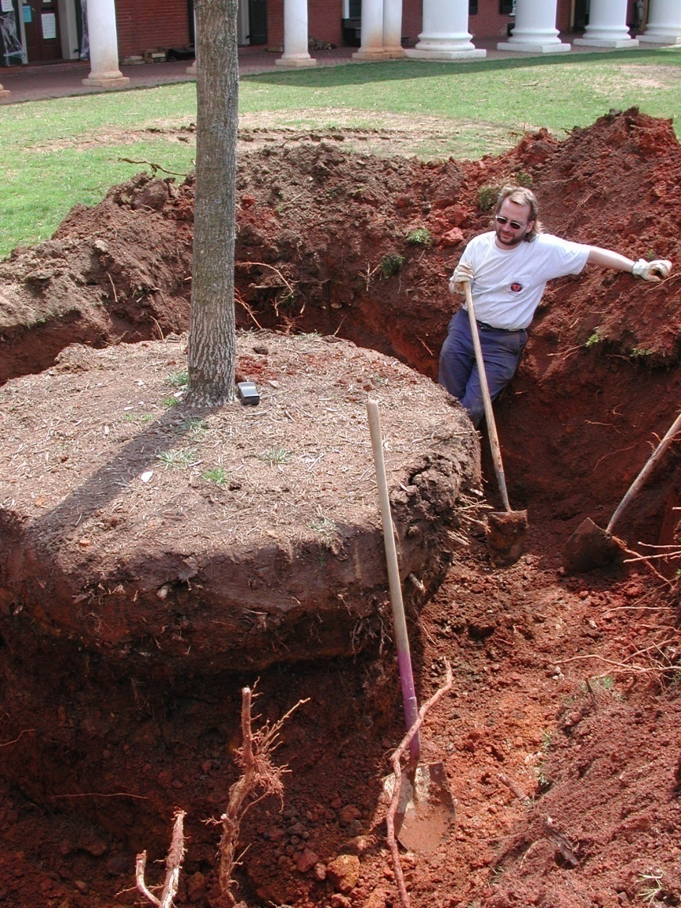
Tree Protection
Relocations
Hand dig

Slide 28
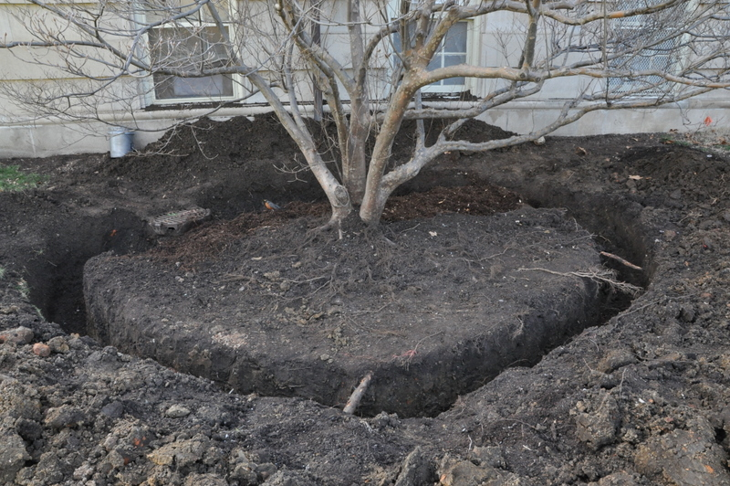
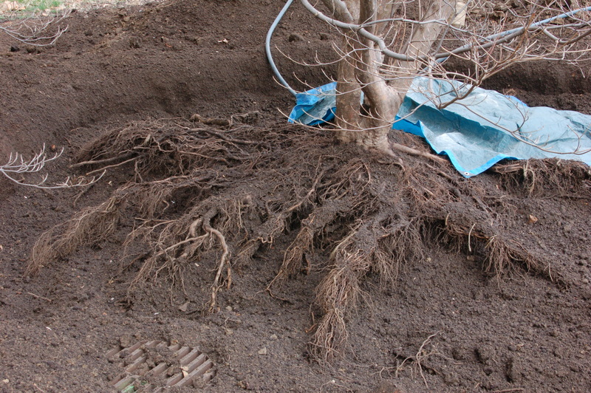
Tree Protection
Relocations
Air spade & bare root

Slide 29
Tree Protection
Relocations

Slide 30
Tree Protection
Relocations

Slide 31
Tree Management
Why Prune?
Eliminate dead, diseased or damaged wood.
Clearance for vehicles, people &views.
Correct structural problems

Slide 32
Tree Management
How to Prune?
Flush cut vs.
natural target pruning

Slide 33
Tree Management
How & What to Prune?
Young trees 2 years
Mid-sized 3-5 years
Mature trees 5+ years
When’s the best time to prune?

Slide 34
Tree Management
Don’t Pollard Trees (generally)

Slide 35
Tree Management
Arborist Staffing
Contract vs. in-house
International Society of Arboriculture
(ISA) certification

Slide 36
Tree Management
Mulching
Why?
Weed suppression
Moisture infiltration & retention
Soil improvement
Nutrients
Trunk & root protection

Slide 37
Tree Management
Mulching
Mulch materials

Slide 38
Tree Management
Mulching
How & how much?

Slide 39
Plans, Programs & Inventories
Tree Campus USA – Arbor Day Foundation
Tree Management Plan
Tree Inventories & Valuation
Tree Replacement Plan
Memorial Trees
Arboretum

Slide 40
Questions?
Tom Flood
tflood@udel.edu
University of Delaware

