Slide 1
Grounds Maintenance Programs
APPA Institute for Facilities Management
Tom Flood, ASLA, CEFP, MBA
Assoc. VP Facilities Operations
University of Delaware

Slide 2
Learning Objectives
1. Purpose & Organizational Goals
2. Maintenance Levels, Parts & Priorities
3. Organizational Structures
4. Resources - Facilities, Equipment, Financial
5. Staffing
6. Snow Removal

Slide 3
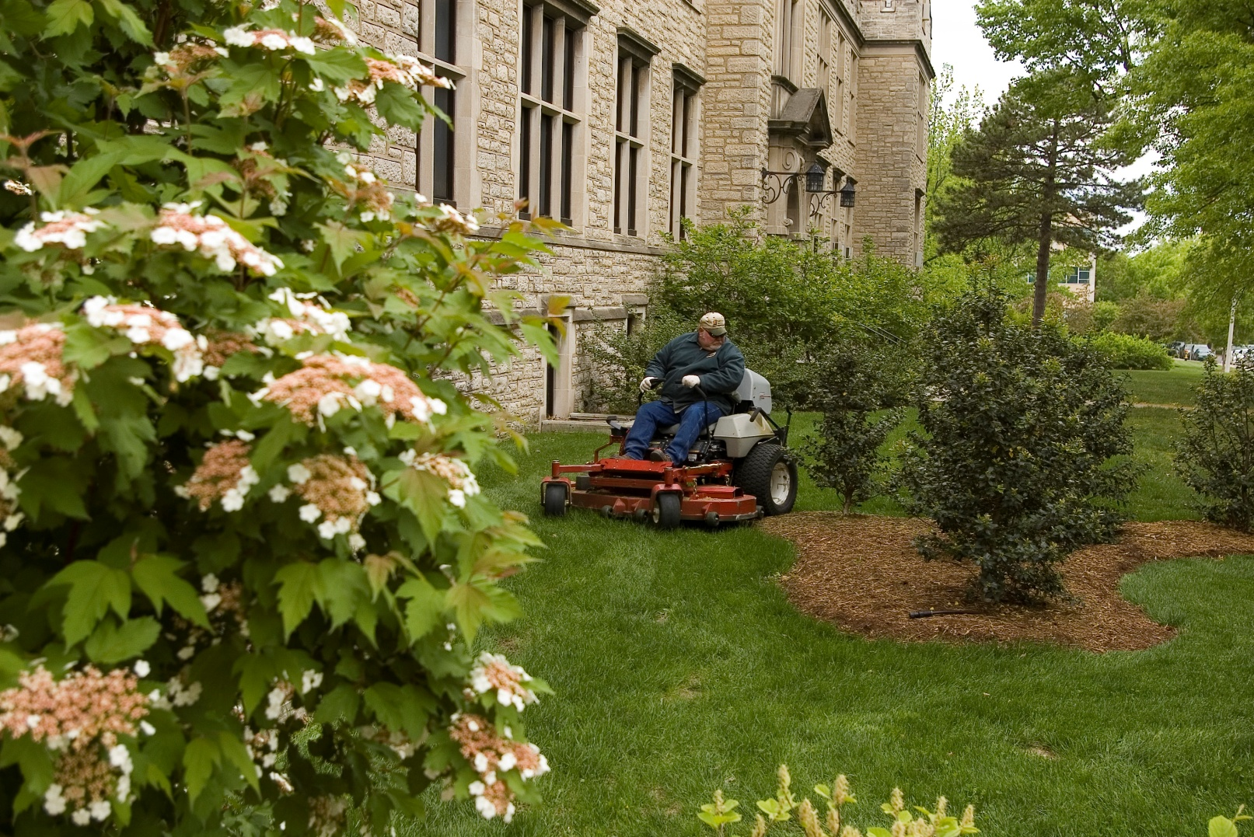
Purpose of Grounds Management

Slide 4
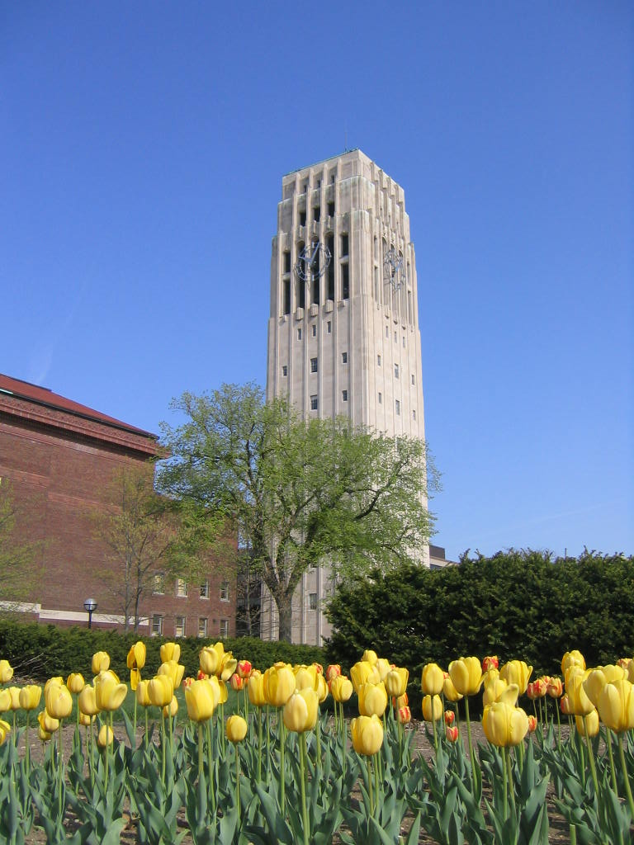
Organizational Goals/Mission
Attractive
Marketing
Safe
Functional
Low Cost
Educational Resource

Slide 5
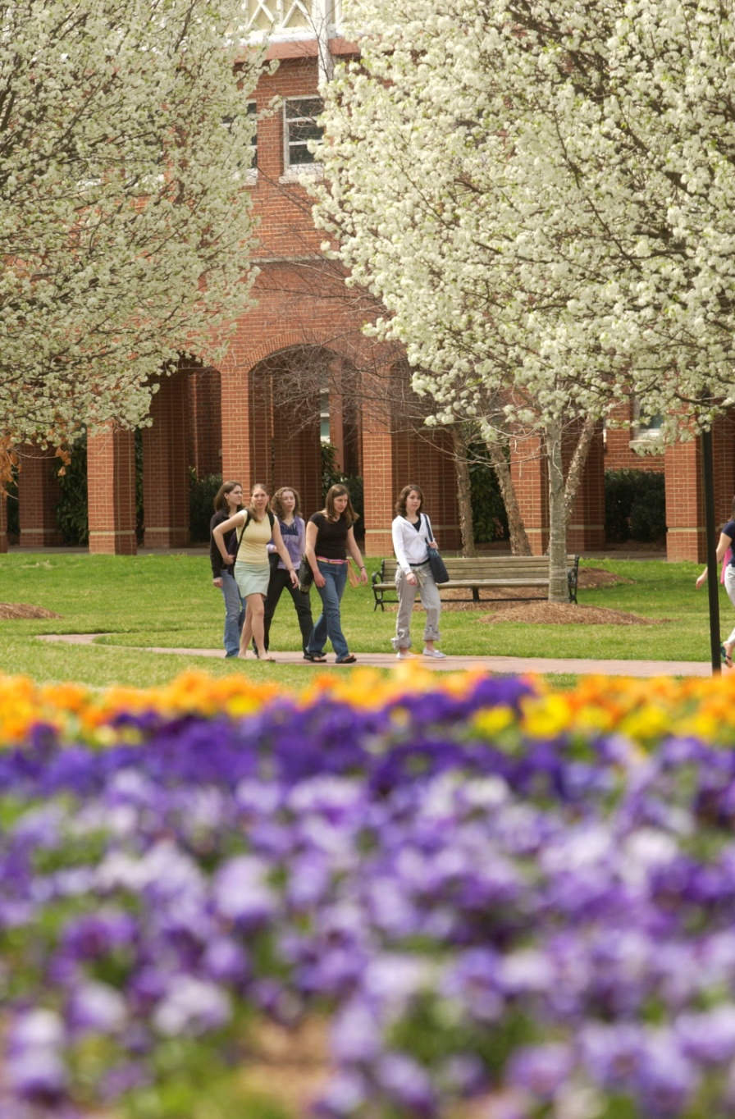
62% of high school seniors were most influence by the appearance of the building and grounds during their visit to college campus.
How Do Students Choose a College,1986, Carnegie Foundation for the Advancement of Teaching

Slide 6
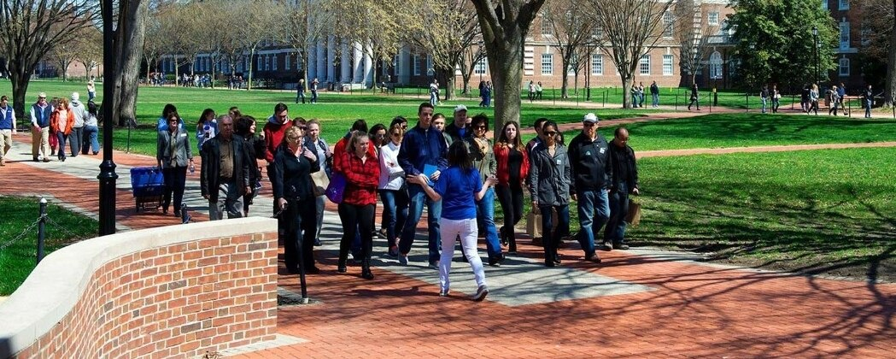
Students visit an average of 10 college campuses.
National Association of College Admissions Counselors
47 % of students said the campus visit was the most influential factor in their college selection.
2009, How Students Really Decide; College Selection From the Inside. Zinch.com

Slide 7
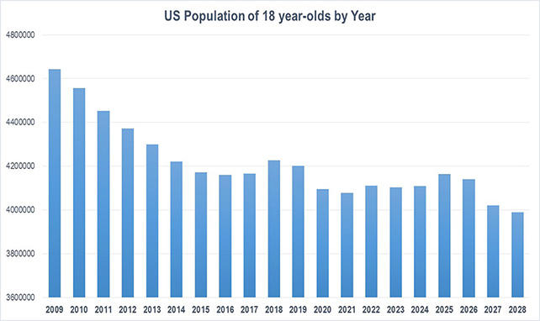

Slide 8
APPA Grounds Maintenance Levels
Level 6 – Natural areas
Level 5 – Minimum-level
Level 4 – Moderately low-level
Level 3 – Moderate-level
Level 2 – High-level
Level 1 – State-of-the-art
What level is your school?

Slide 9
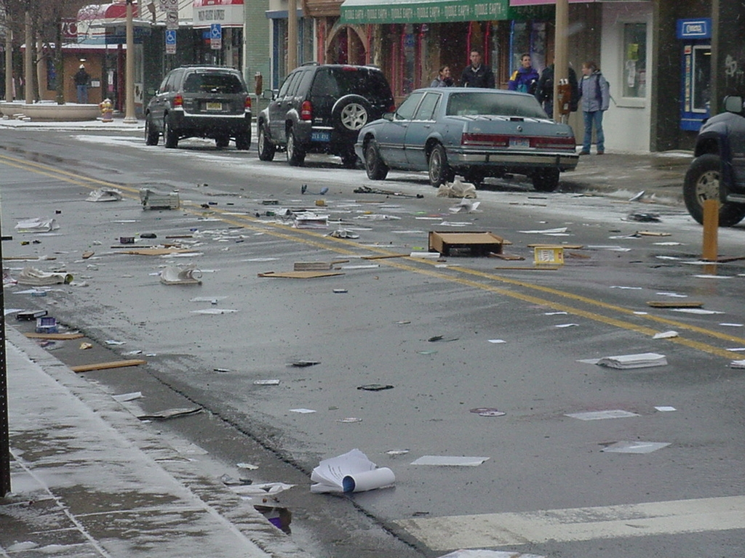
Parts & Priorities
APPA Level 3 - ‘Clean & Green’
Litter Collection
2-3 /wk

Slide 10
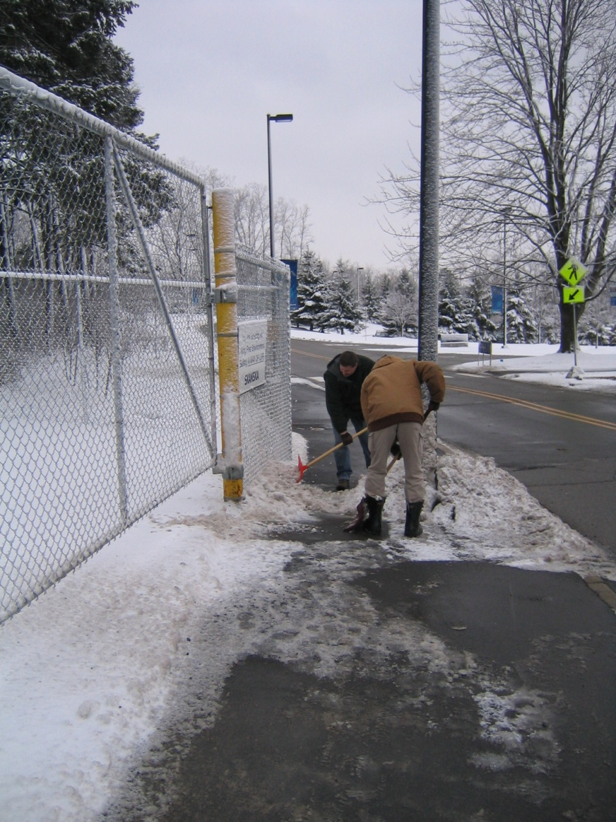
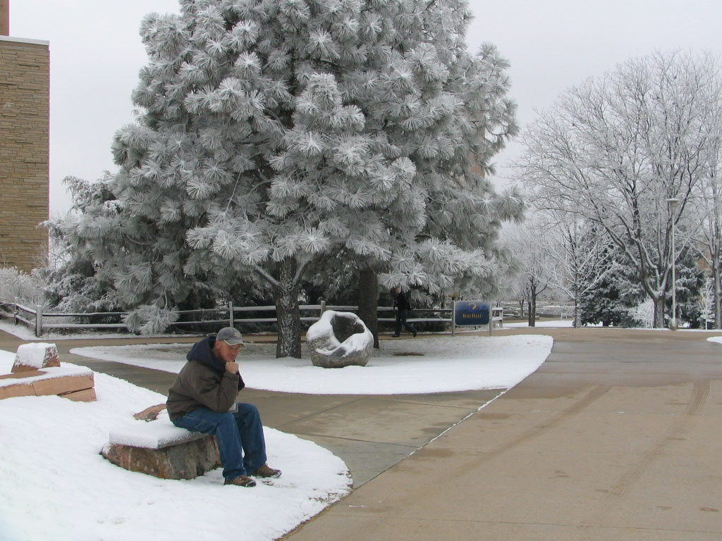
Parts & Priorities
Level 3 - ‘Clean & Green’
Snow Removal

Slide 11
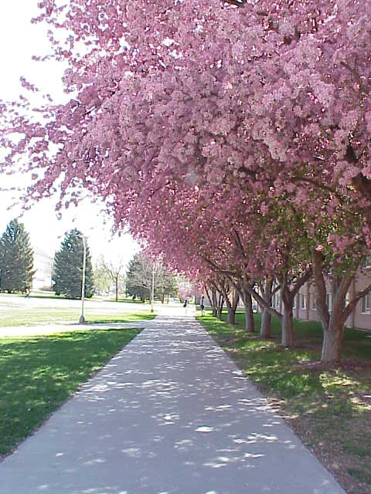
Parts & Priorities
Level 3 - ‘Clean & Green’
Mow,Trim, Blow & Go
Mow1 / 7-10 days
Fertilize 1/yr
Litter 3 /wk

Slide 12
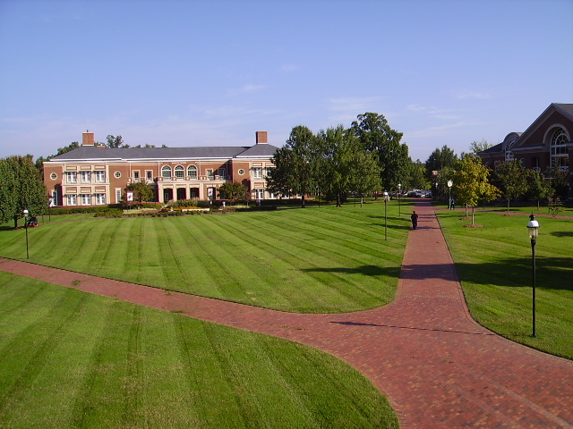
Parts & Priorities
APPA Level 2 – ‘The Academic Village’
Turf Management
Mow 1/wk
Fertilize 1+/yr
Irrigation
Weed Control
Aerate
Overseed

Slide 13
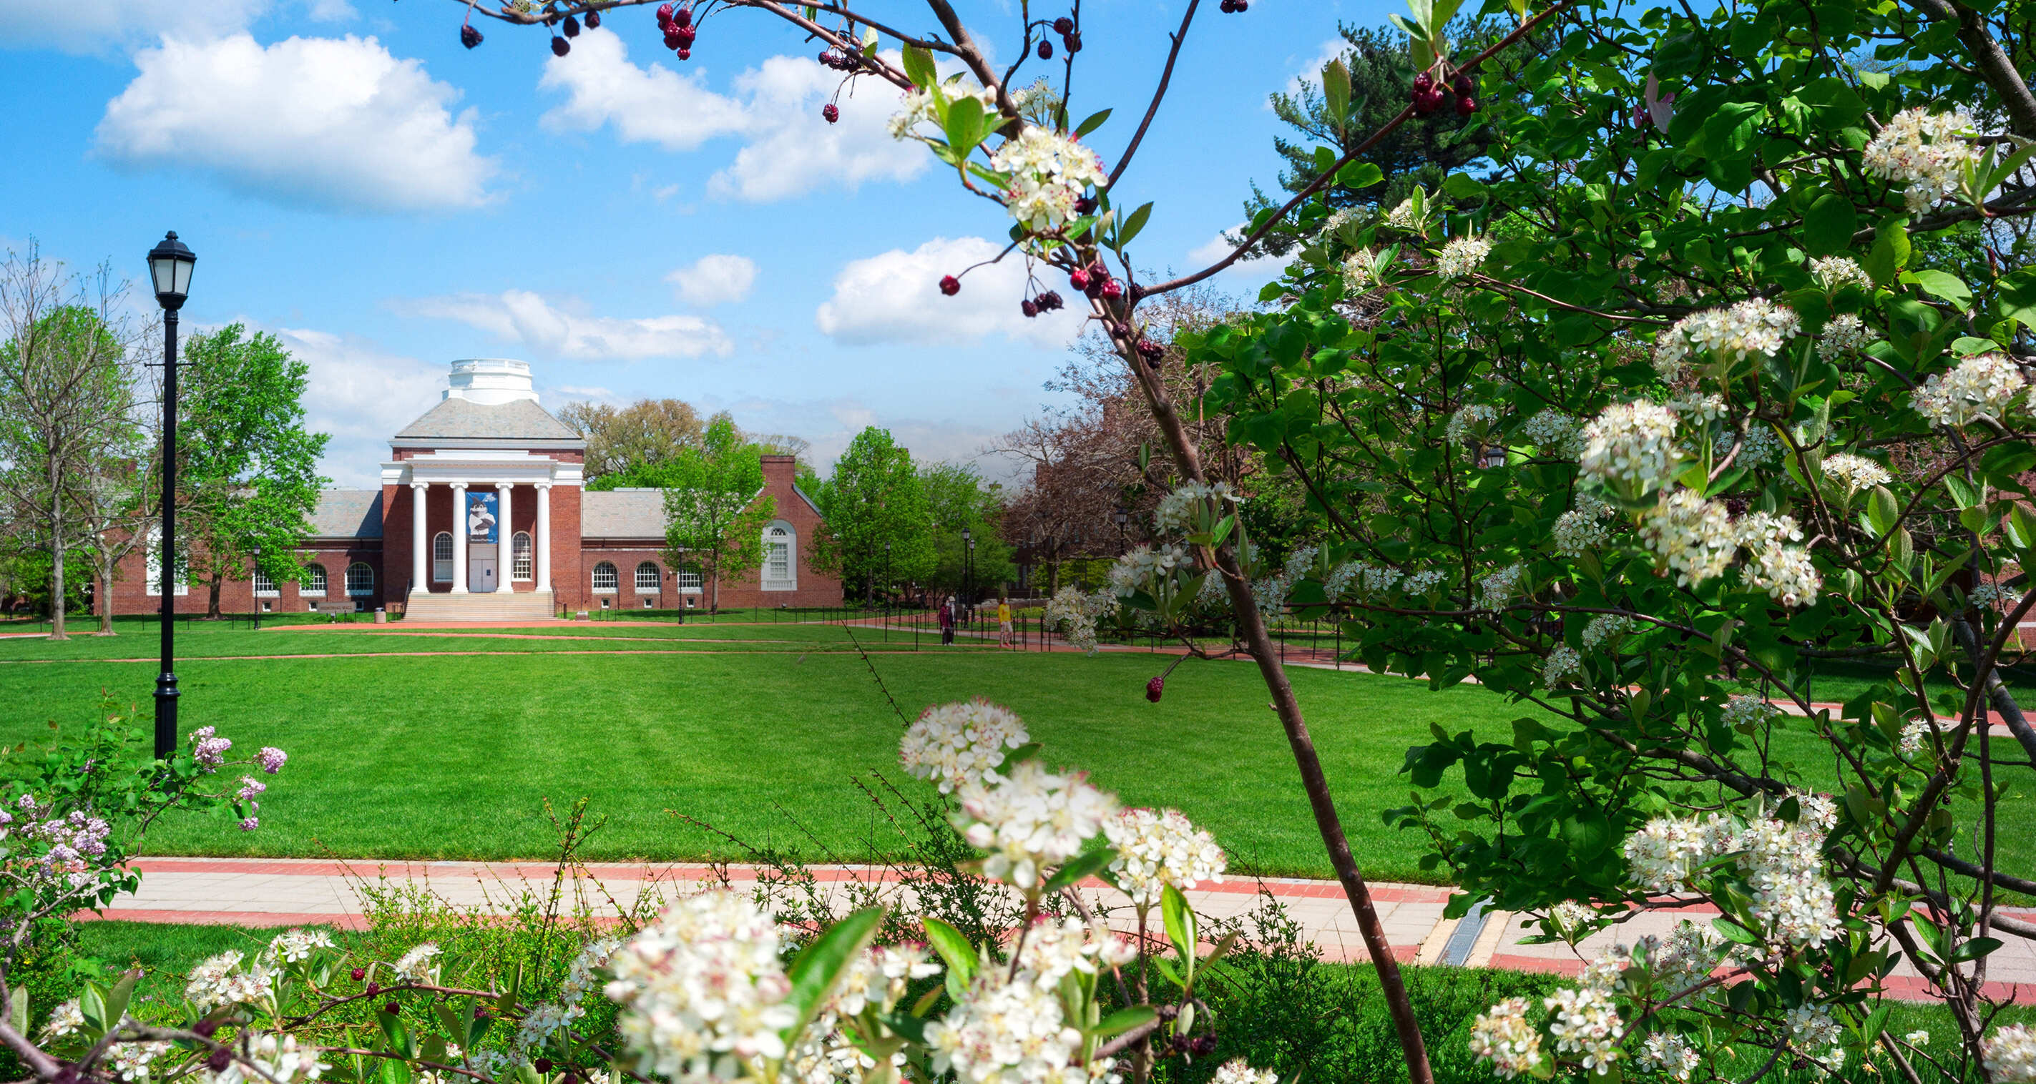
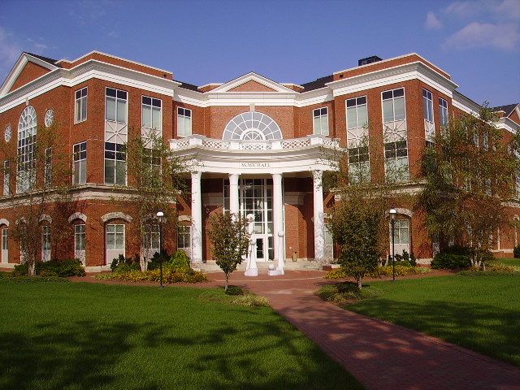
Parts & Priorities
Level 2 – ‘The Academic Village’
Tree management
Shrub plantings
Litter, 5+ days/wk

Slide 14
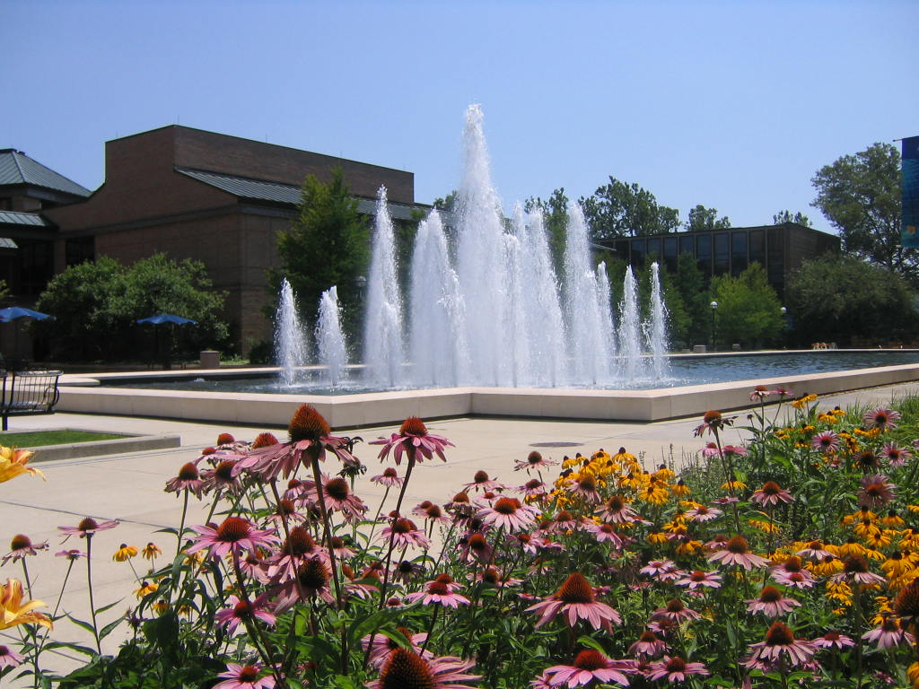
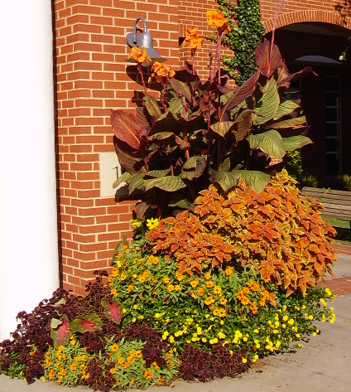
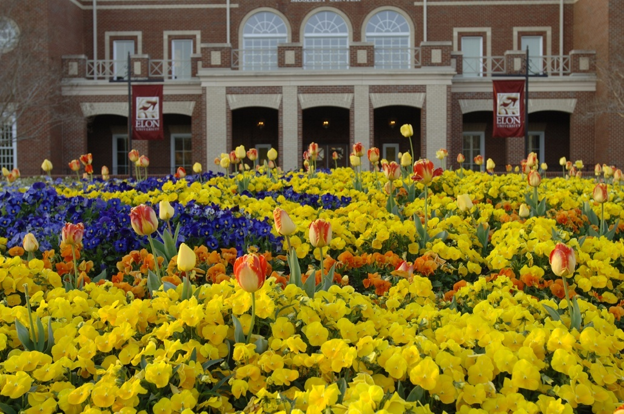
Parts & Priorities
APPA Level 1 – ‘The Campus Garden’
Annual & Perennial Flowers

Slide 15
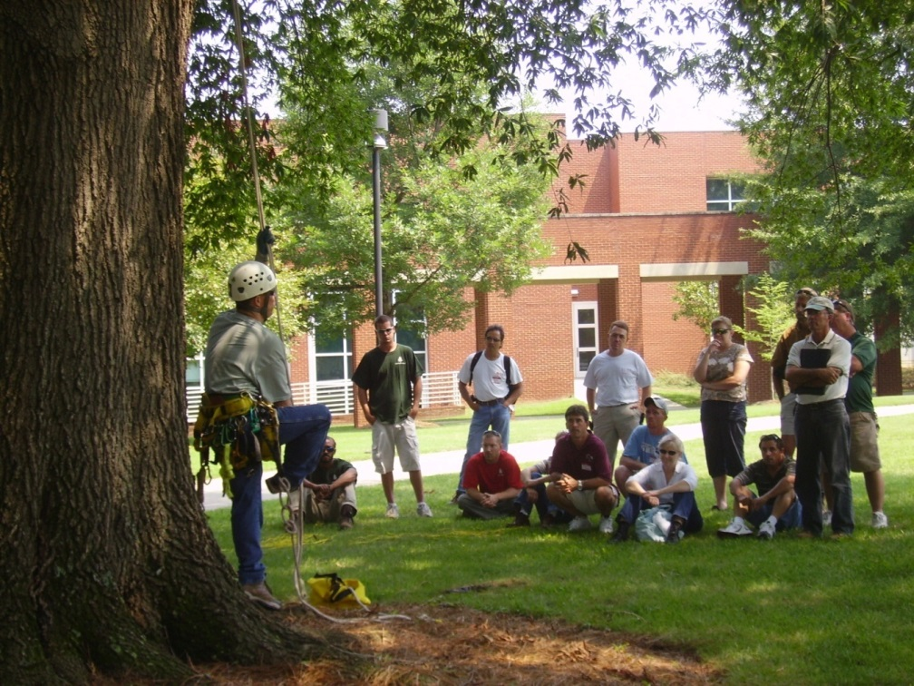
Parts & Priorities
APPA Level 1 – ‘The Campus Garden’
- Botanical Gardens & Arboreta

Slide 16
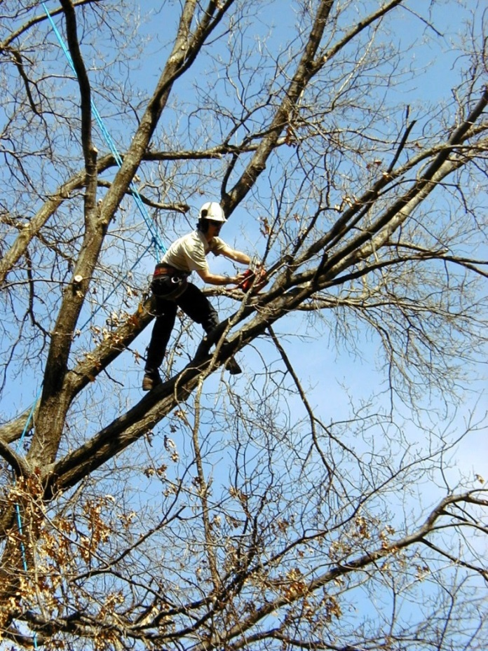
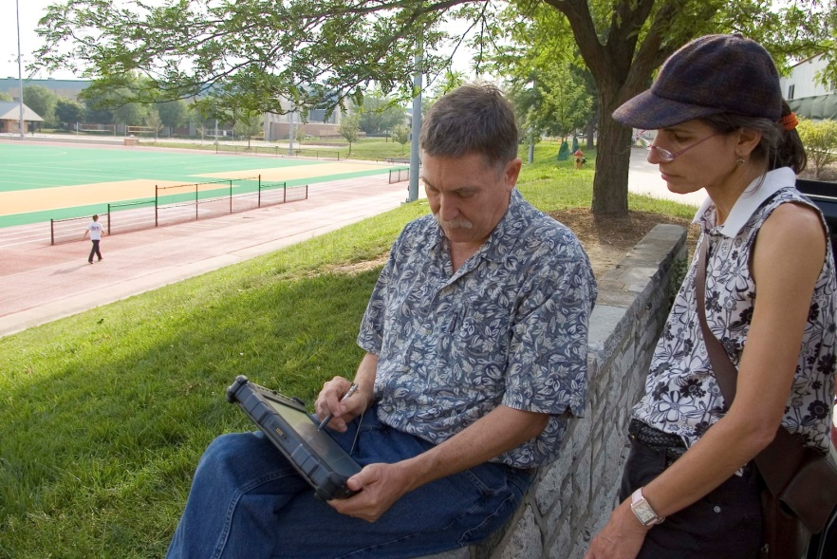
Parts & Priorities
APPA Level 1 – ‘The Campus Garden’
Arboriculture
Tree inventory & appraisal

Slide 17
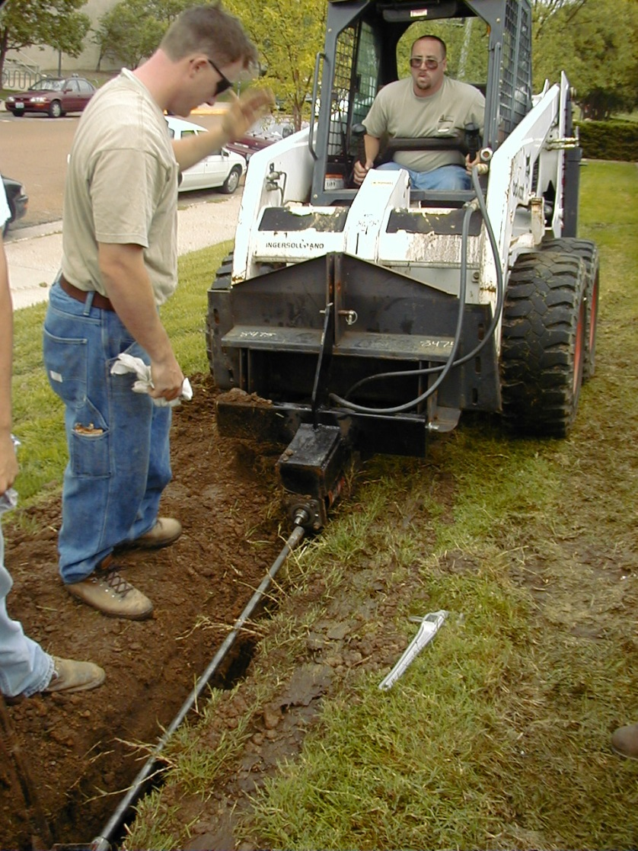
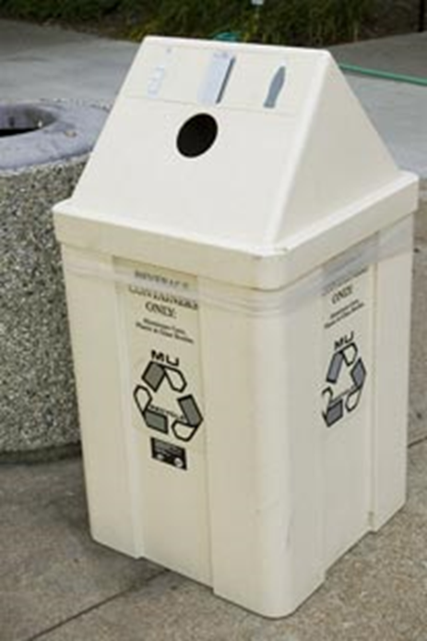
Miscellaneous Services
Pavement Management
Waste & Recycling
Composting
Site Furnishings
Landscape Construction
Landscape Architecture

Slide 18
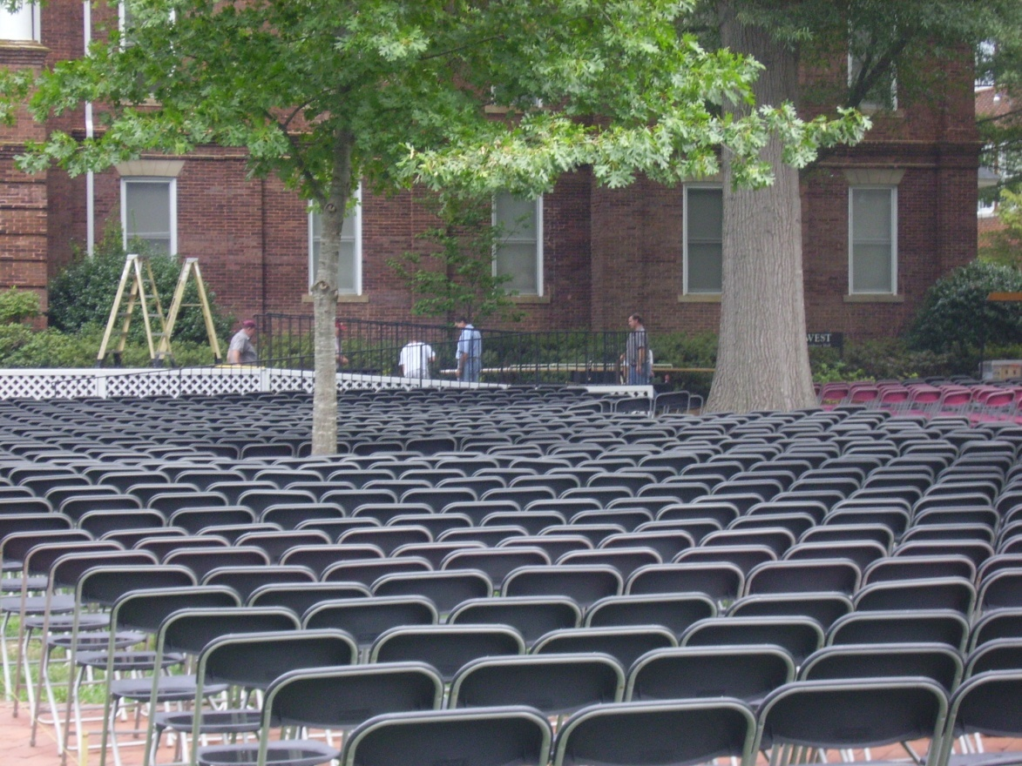
Conflicting Services
Moving & Setups
Labor Shop
~The tyranny of the urgent trumps the completion of the important.

Slide 19
Organizational Structure – task based
Landscape Services
Superintendent
Athletics
Sports Turf
Manager
Turf Crew
Lead Groundskeeper
Horticulture
Lead Gardener
Landscape Const.
Supervisor
Irrigation Technician
Lead Groundskeeper
Groundskeeper
Gardener
Groundskeeper
Groundskeeper
Gardener
Groundskeeper
Small Engine Mechanic
Arborist
Seasonal
Groundskeepers

Slide 20
Organizational Structure – zone based
Landscape Services
Superintendent
Athletics
Sports Turf
Manager
Center Campus
Supervisor
North Campus
Supervisor
Research Campus
Landscape Gardener
Irrigation Technician
Lead Groundskeeper
Landscape Gardener
Lead Groundskeeper
Groundskeeper
Groundskeeper
Gardener
Groundskeeper
Groundskeeper
Groundskeeper II
Groundskeeper
Gardener
Groundskeeper
Gardener
Temporary
Groundskeeper
Groundskeeper
Small Engine Mechanic

Slide 21
Organizational Structures
Task
More efficient use of labor
More efficient use of equipment
Less ownership
May be less pride
Easier to train employees
More monotony
Zone
Less efficient use of labor
More equipment required
More ownership = pride
More accountability
May create silos
More training required
Greater job satisfaction

Slide 22
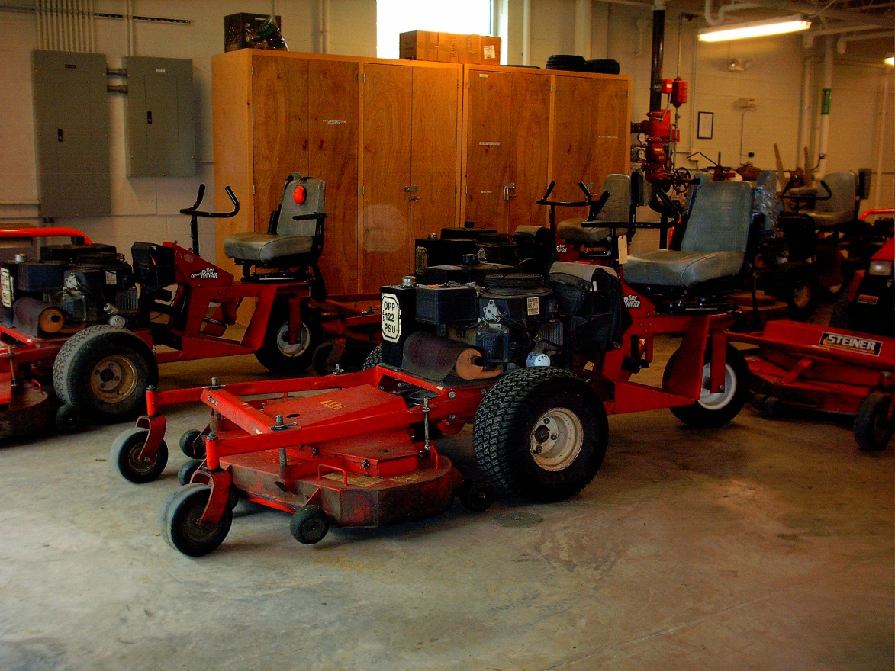
Resource Requirements
Facilities
- Equipment shop
- Covered storage
- Bulk materials
storage
- Holding nursery

Slide 23
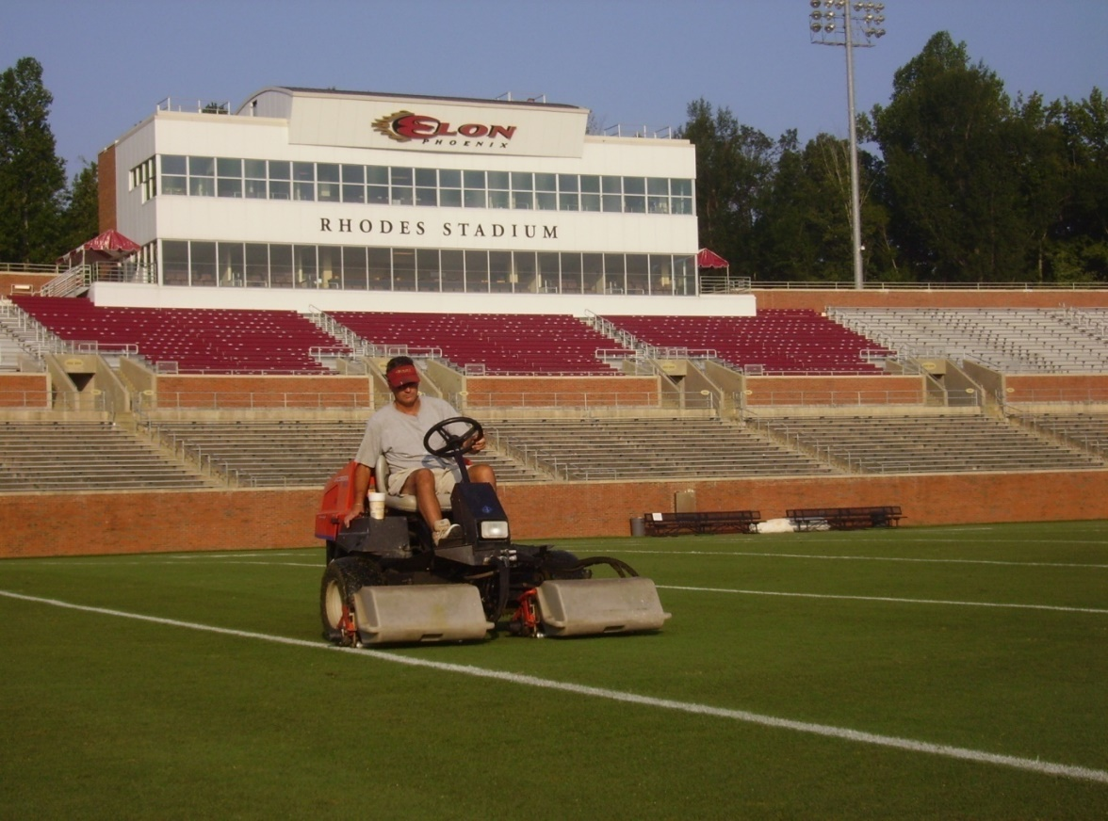
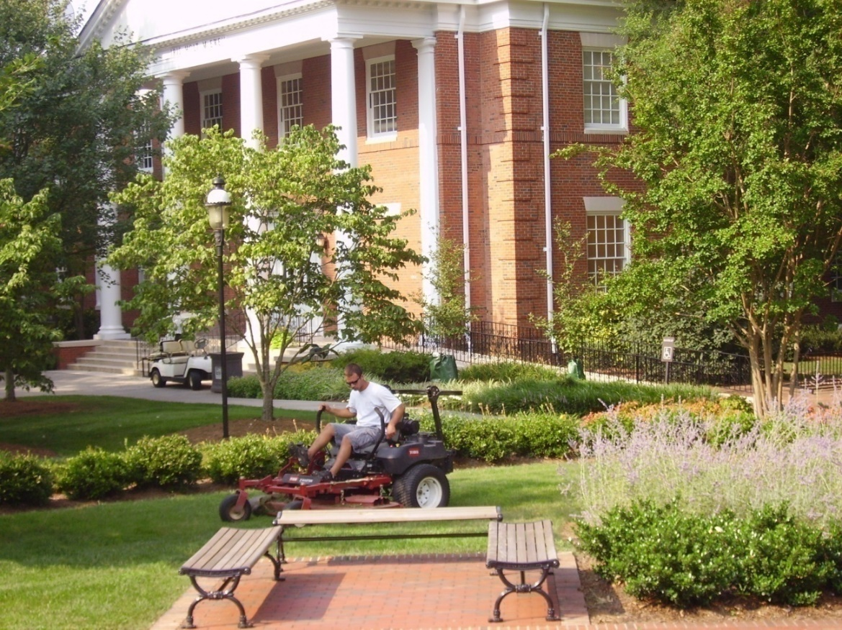
Resource Requirements
Equipment
- Reel & Rotary Mowers

Slide 24
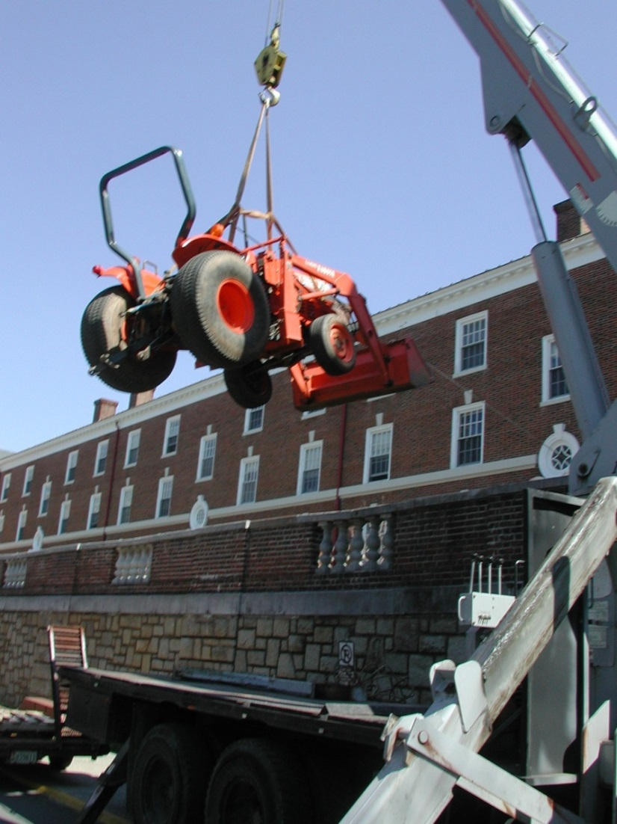
Resource Requirements
Equipment
- Blowers, edgers, etc
- Tractors
- Spreaders / sprayers
- Miscellaneous
~ 5%-10% of op. budget
in capital equipment
annually

Slide 25
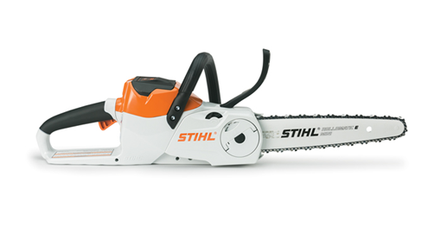
Electric Equipment options

Slide 26
Resource Requirements - Financial

Slide 27
Resource Requirements - Financial

Slide 28
Resource Requirements - Financial
The 95/5 rule
95 % of the grounds budget is taken by tasks that only 5% of the customers notice.
But 95% of the customers notice what we spend only 5% of the grounds budget on.

Slide 29
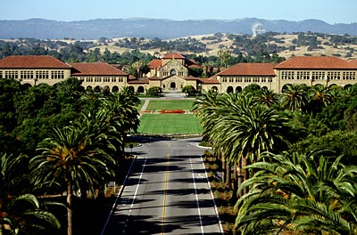
Resource Requirements
Staffing ‘The Holy Grail’
- Comparative issues
Climate
Quality & expectations
Landscape style
Volume of use
Campus setting
Area measurements

Slide 30
Staffing
Data Sources
Institutional History
APPA Facilities Performance Indicators (FPI)
Operational Guidelines for Grounds Management - APPA

Slide 31
APPA FPI

Slide 33
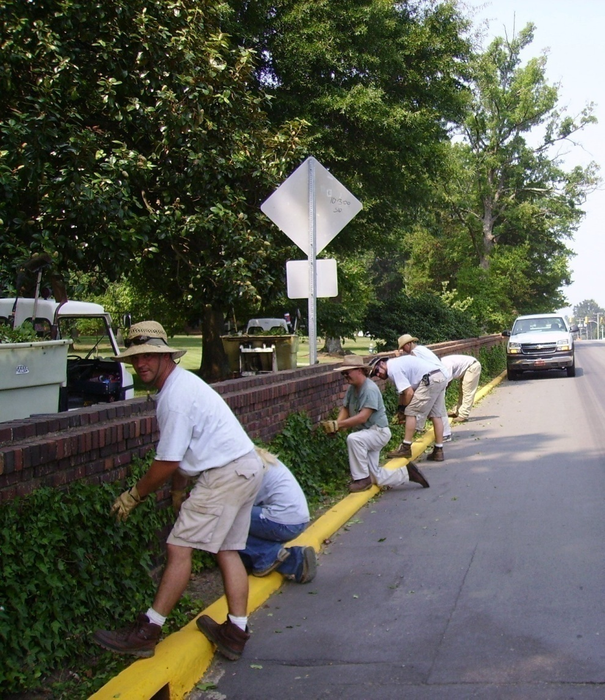
Resource Requirements
APPA Staffing Level 1
High use/
high visibility areas,
3 – 7 Acres / FTE

Slide 34
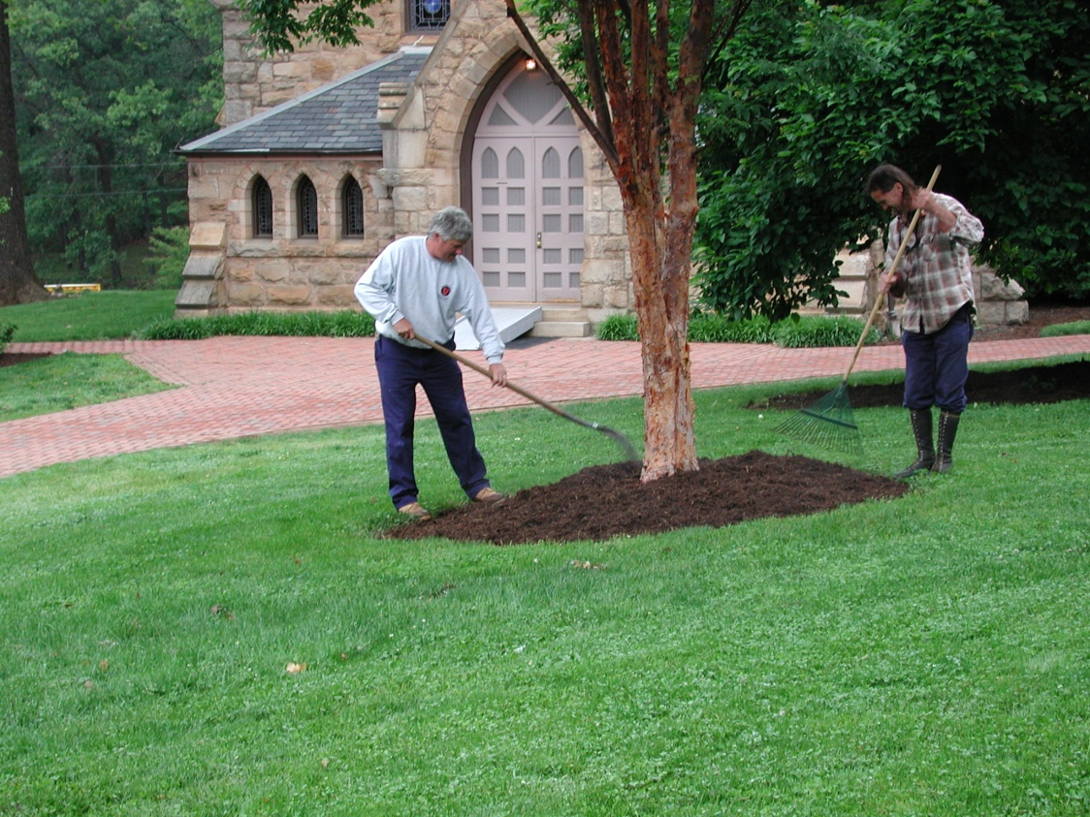
Resource Requirements
APPA Staffing Level 2
Medium use & visibility areas,
7 - 14 Acres / FTE

Slide 35
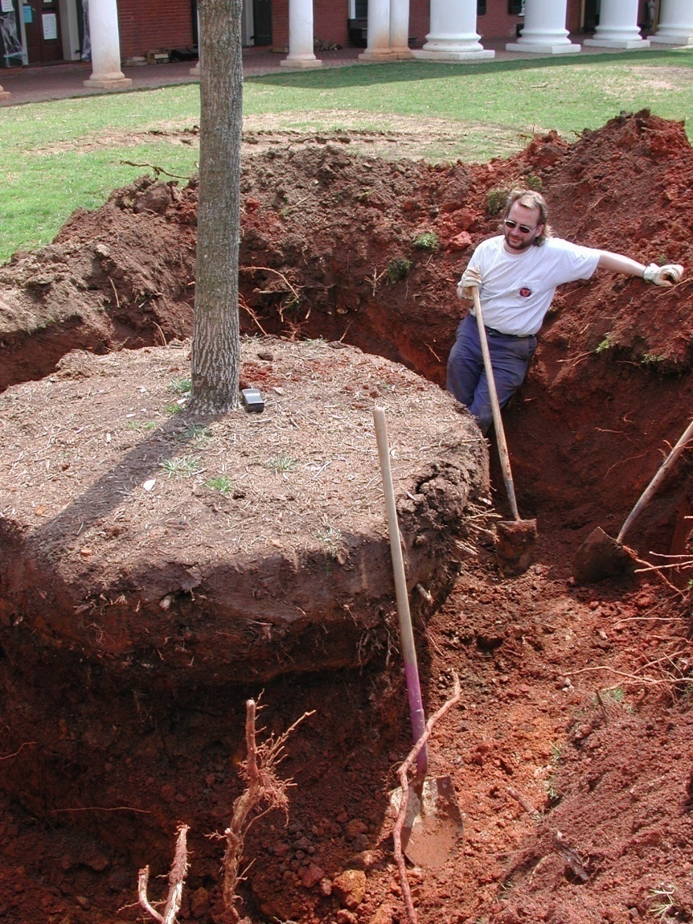
Resource Requirements
APPA Staffing Level 3-4
Low use areas,
14- 100 Acres / FTE

Slide 36
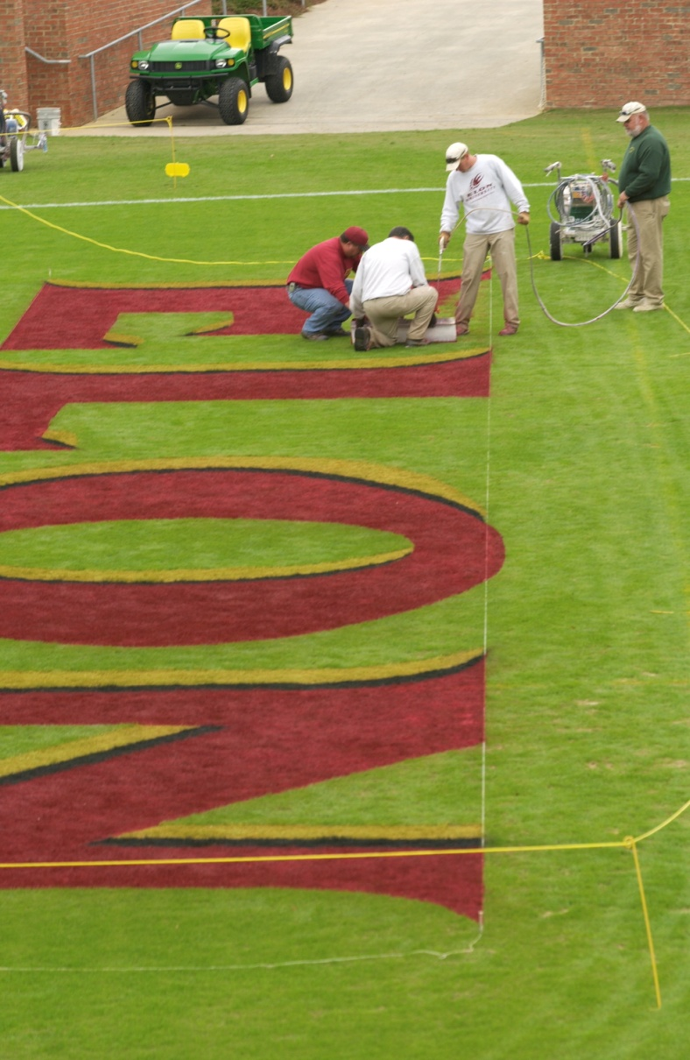
Resource Requirements
Staffing
Athletic fields – NCAA
1 – 3 Fields/ FTE

Slide 37
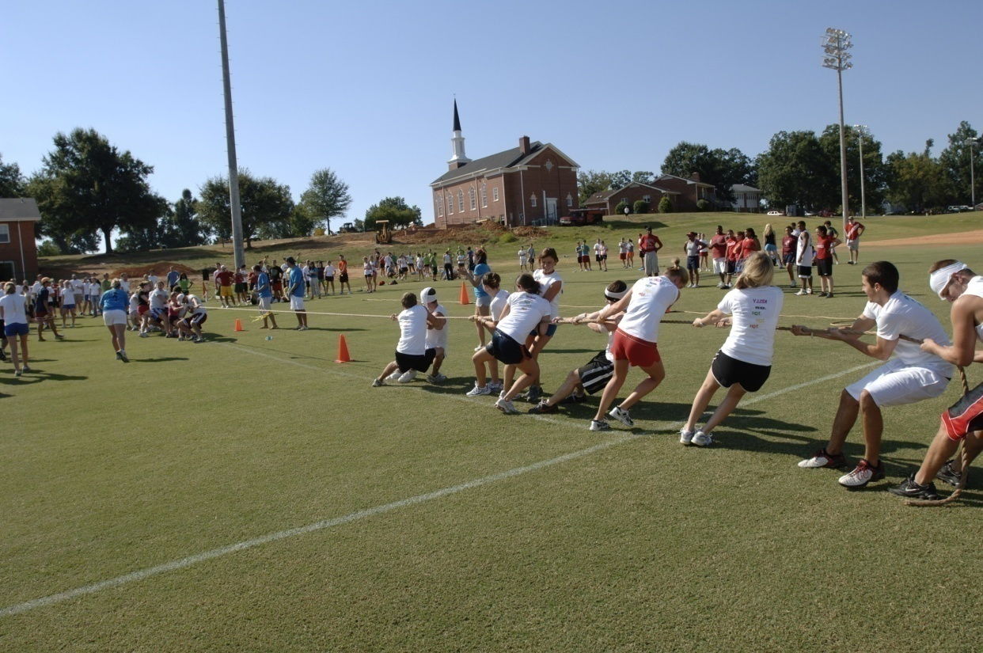
Resource Requirements
Staffing
Athletic fields – Recreational
3 - 6 Fields/ FTE

Slide 38
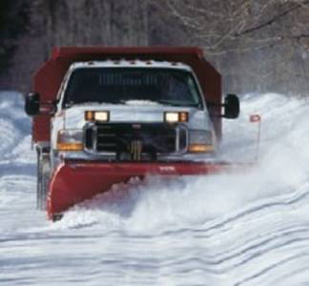
Snow Removal

Slide 39
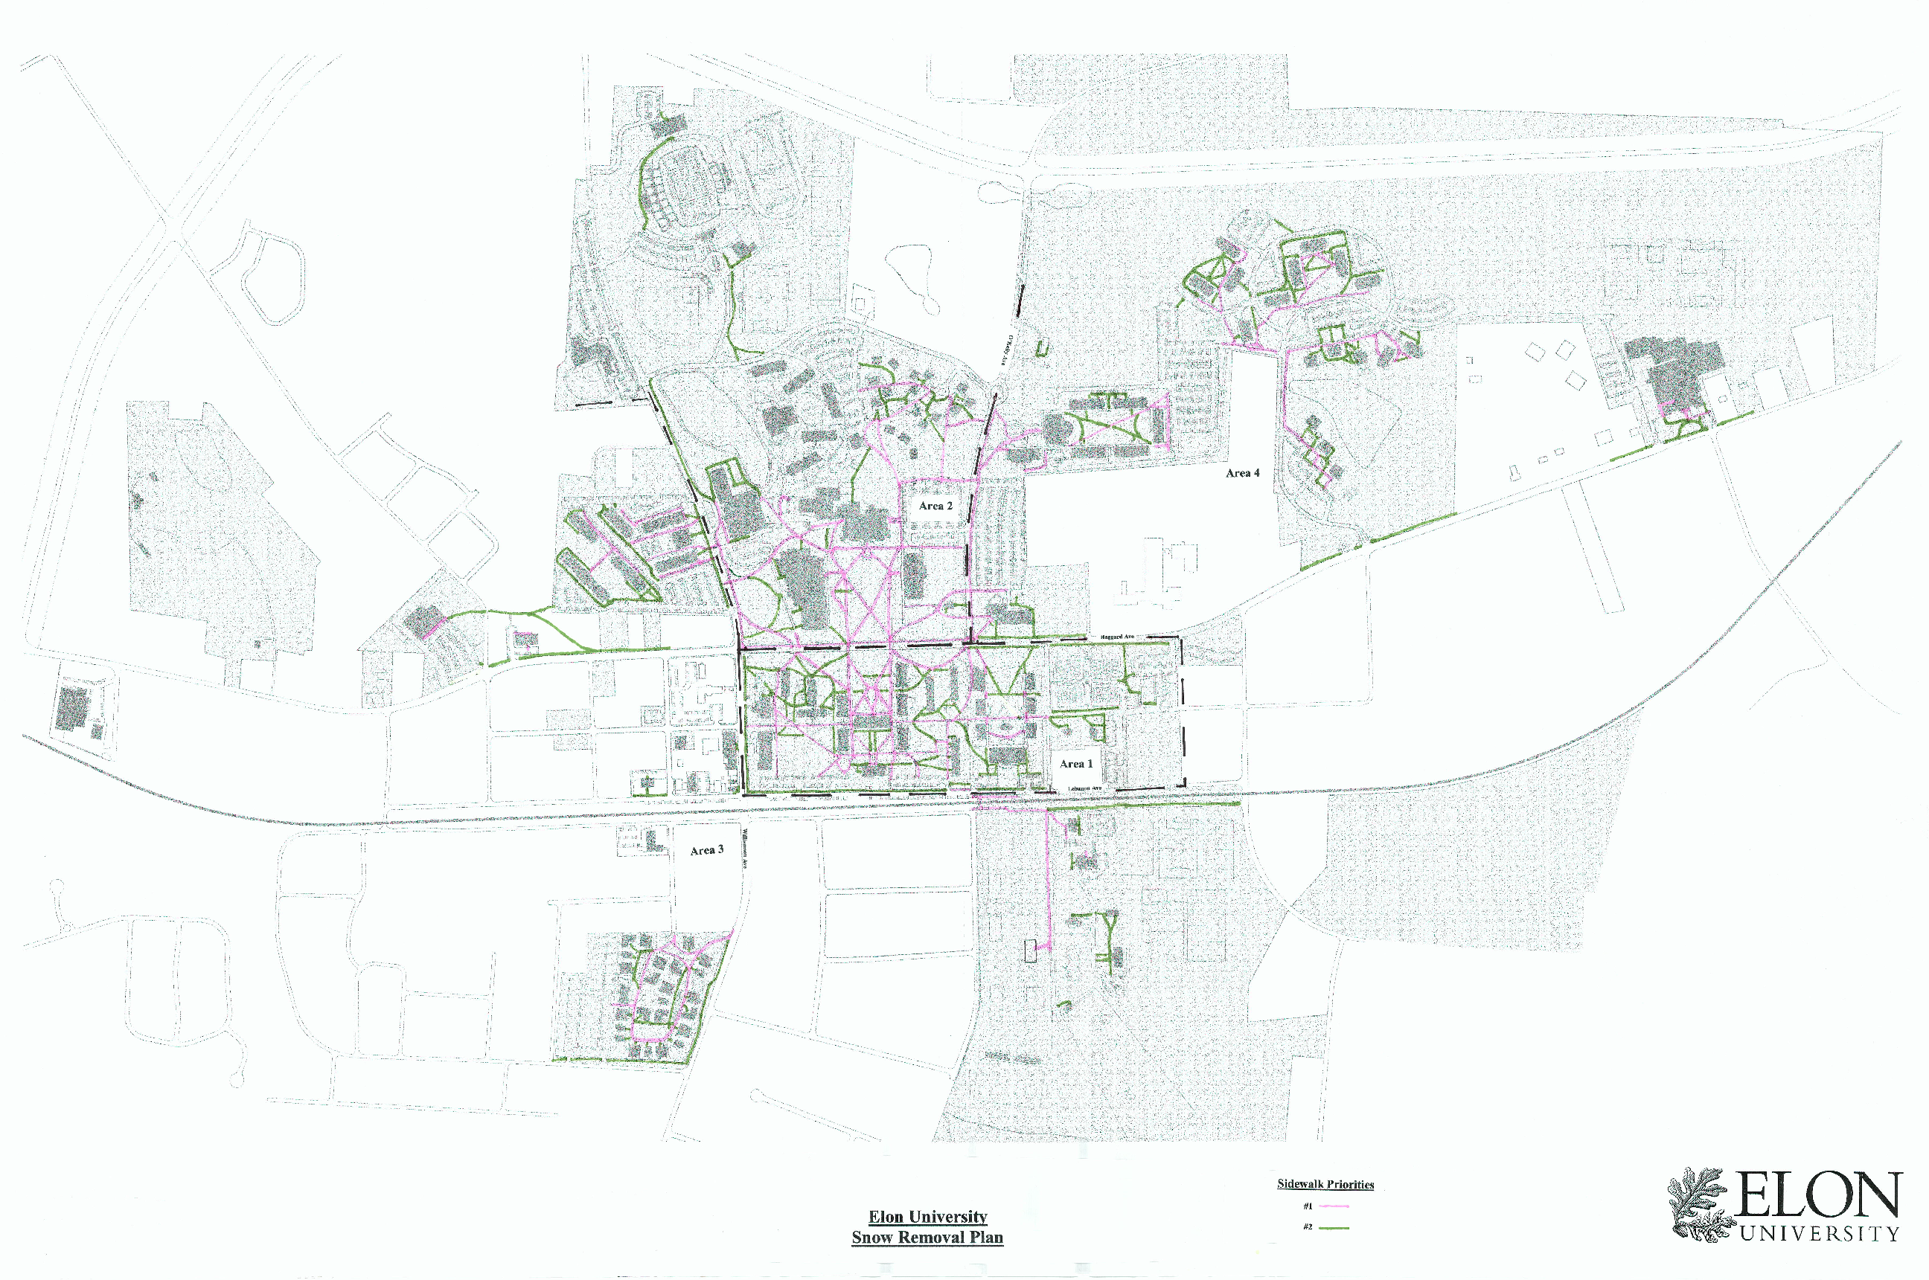
Snow Removal - Response Plans
By Priority
By Zone
By Equipment Assignment
Reasonable and Defendable

Slide 40
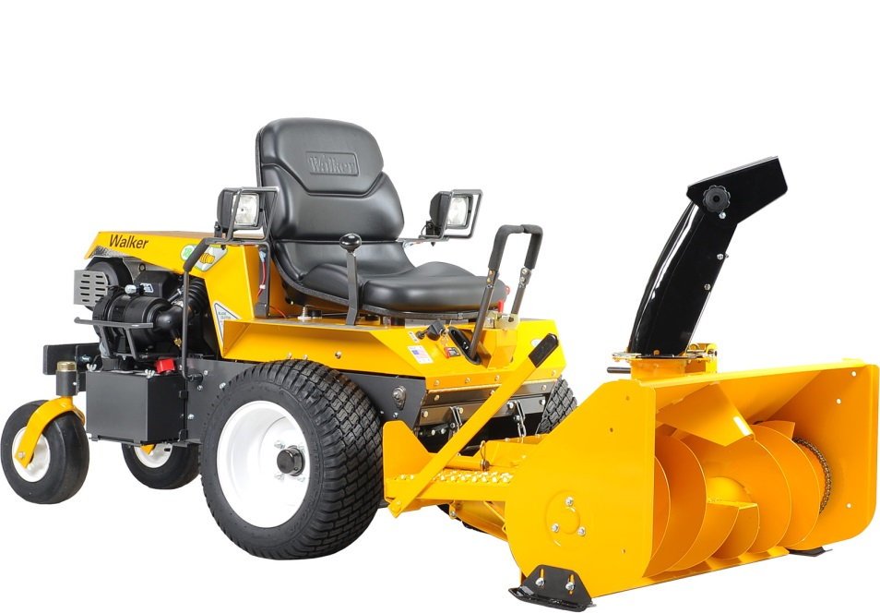
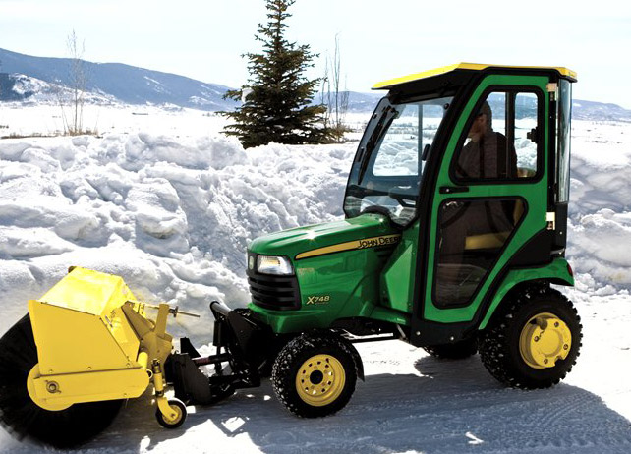
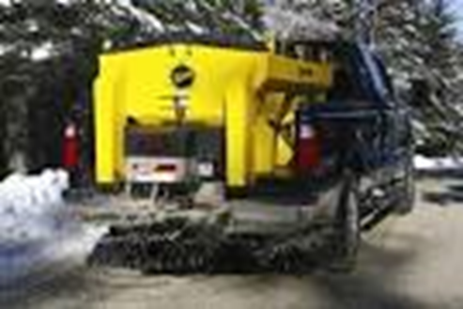
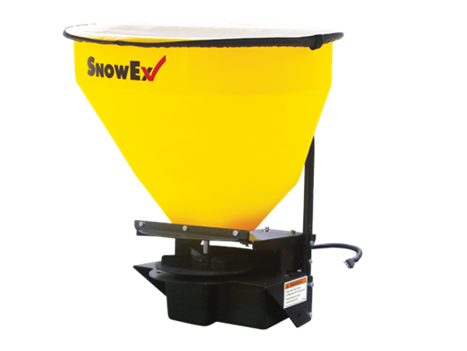
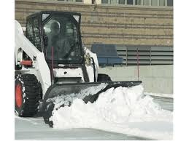
Snow Removal
- Equipment
cost ranges 0-50% of operating budget

Slide 41
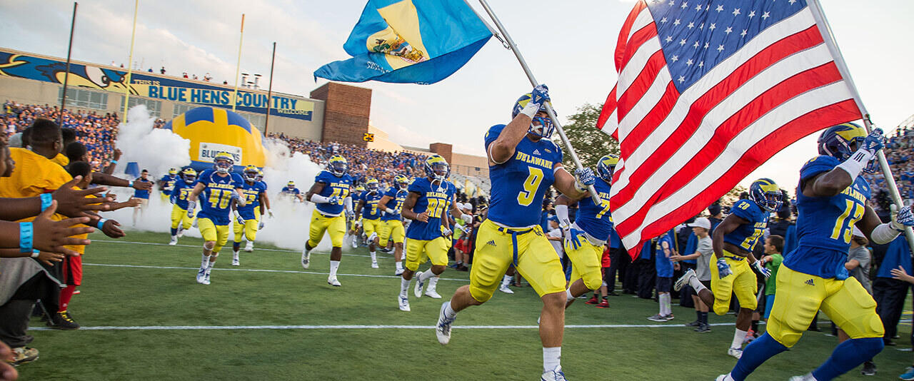
Athletics & Synthetic Turf Professional Sports Field Management Manage for Student Athlete Safety (it’s not just grass)

Slide 42
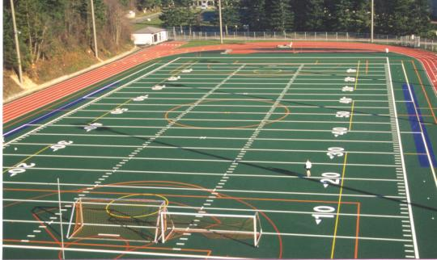
Professional Sports Field Management Natural vs. Synthetic
Considerations
Capital cost
Life cycle cost
Maintenance needs
Number of sports
Multiple lines
All weather use
Surface temperature
Painting and scrubbing
Injury & playability
Coach preferences

Slide 43
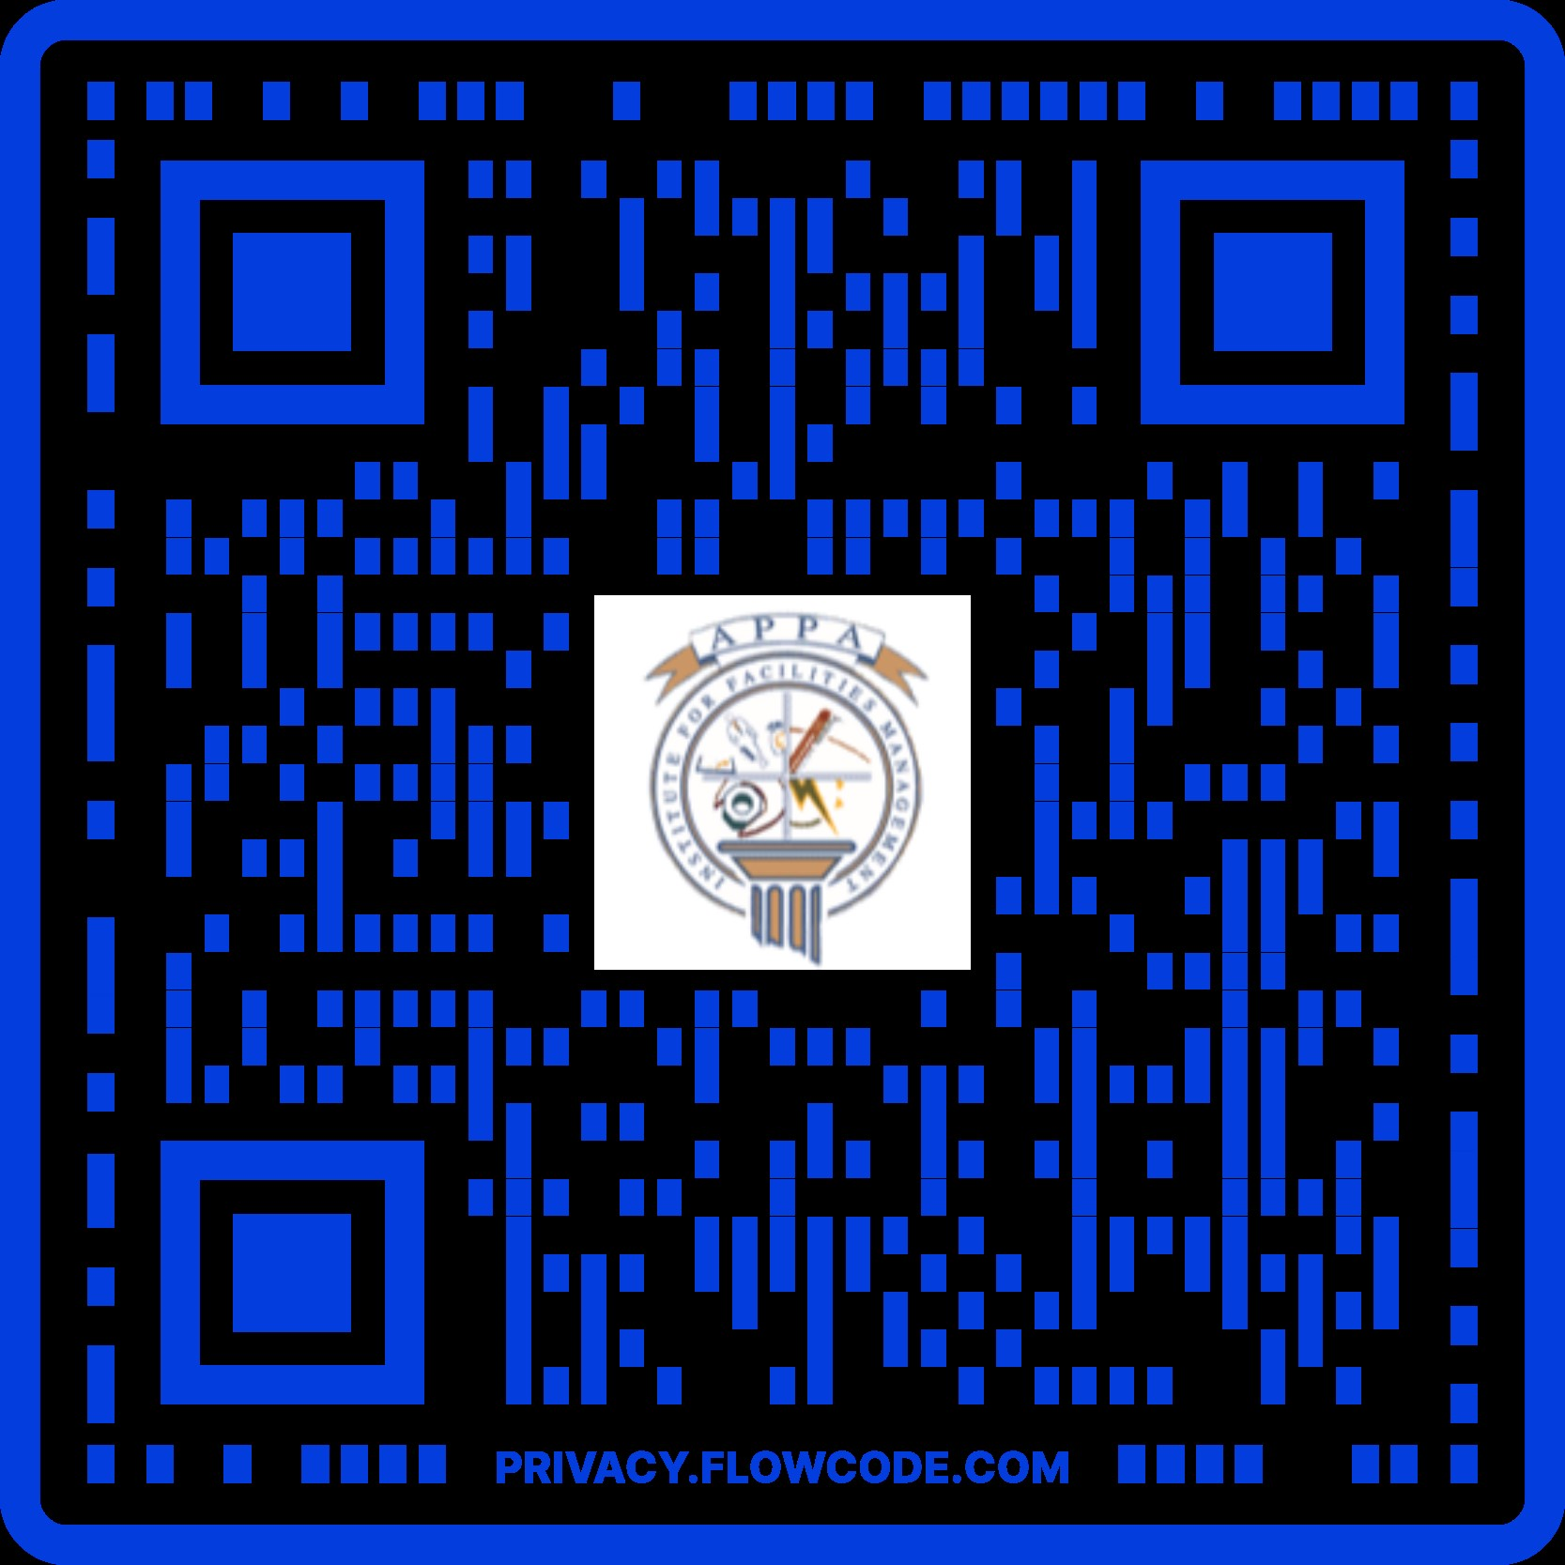
QUESTIONS? Tom Flood tflood@udel.edu University of Delaware
This concludes The American Institute of Architects Continuing Education Systems Course

